Slide 1

ICDL COURSE
Lecture 4

Slide 2
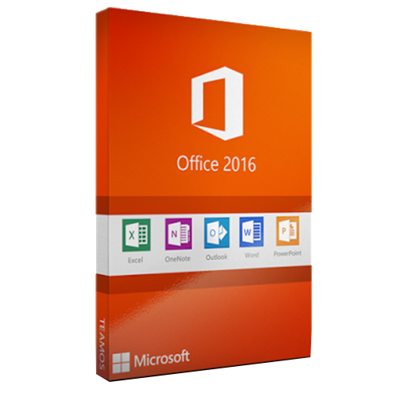


Welcome To Microsoft Access 2016

Slide 3

Microsoft Acess
Microsoft Access is a database creation and management program. To understand Access, you must first understand databases.
In this lesson, you will learn about databases and how they are used. You will familiarize yourself with the differences between data management in Microsoft Access and Microsoft Excel. Finally, you will get a look ahead at the rest of the Access tutorial.
Access 2016 allows you to create and manage databases.

Slide 4
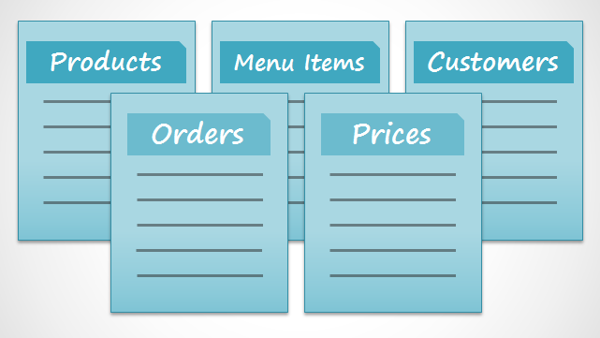
What is a database?
A database is a collection of data that is stored in a computer system. Databases allow their users to enter, access, and analyze their data quickly and easily.
Why use a database?
While Excel is great at storing and organizing numbers, Access is far stronger at handling non-numerical data, like names and descriptions. Non-numerical data plays a significant role in almost any database, and it's important to be able to sort and analyze it.
We call a database like the ones you’ll work with in Access a relational database. A relational database is able to understand how lists and the objects within them relate to one another.

Slide 5
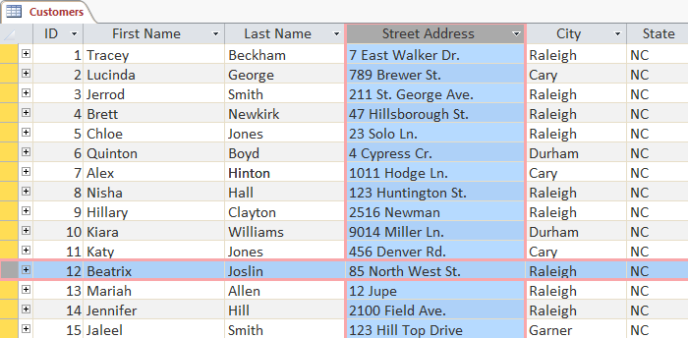
Introduction to Objects
Databases in Access are composed of four objects:
tables, queries, forms, reports. Together, these objects allow you to enter, store, analyze, and compile data however you want.
Tables
By this point, you should already understand that a database is a collection of data organized into many connected lists. In Access, all data is stored in tables, which puts tables at the heart of any database.
You might already know that tables are organized into vertical columns and horizontal rows.
A field is more than just a column; it’s a way of organizing information by the type of data it is. Every piece of information within a field is of the same type.
A record is more than just a row; it's a unit of information. Every cell in a given row is part of that row’s record.

Slide 6
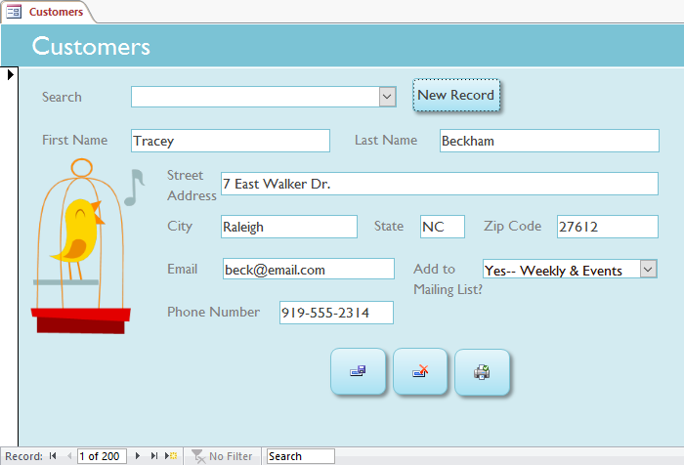
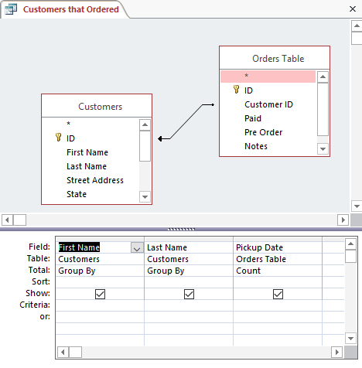
Forms
Forms are used for entering, modifying, and viewing records. You likely have had to fill out forms on many occasions, like when visiting a doctor's office, applying for a job, or registering for school. The reason forms are used so often is that they're an easy way to guide people toward entering data correctly. When you enter information into a form in Access, the data goes exactly where the database designer wants it to go: in one or more related tables.
Queries
Queries are a way of searching for and compiling data from one or more tables. Running a query is like asking a detailed question of your database. When you build a query in Access, you are defining specific search conditions to find exactly the data you want.

Slide 7
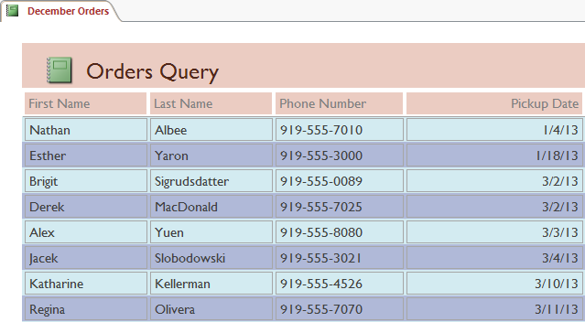
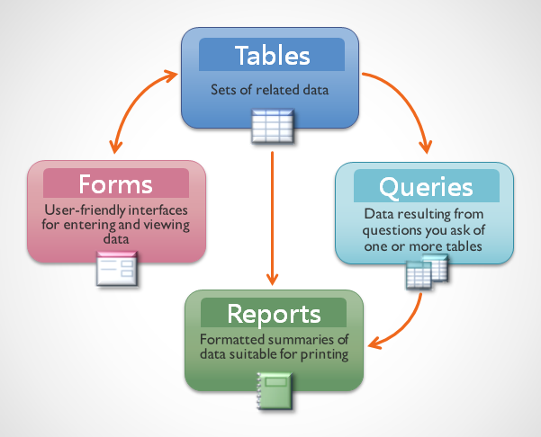
Reports
Reports offer you the ability to present your data in print. If you've ever received a computer printout of a class schedule or a printed invoice of a purchase, you've seen a database report. Reports are useful because they allow you to present components of your database in an easy-to-read format. You can even customize a report's appearance to make it visually appealing. Access offers you the ability to create a report from any table or query.
These relationships sound complicated, but in fact they work together so well and naturally that we often don't even notice when we're using connected database objects.

Slide 8
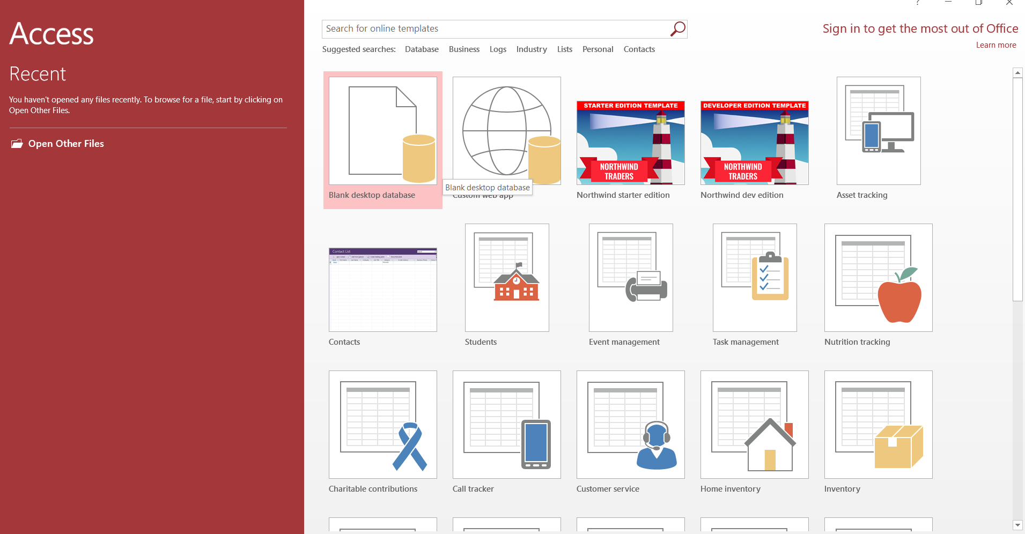
Acess Interface
When you open Access 2016 for the first time, the Access Start Screen will appear. From here, you'll be able to create a new database, choose a template, and access your recently edited databases.
From the Access Start Screen, locate and select Blank desktop databases to access the Access interface.

Slide 9
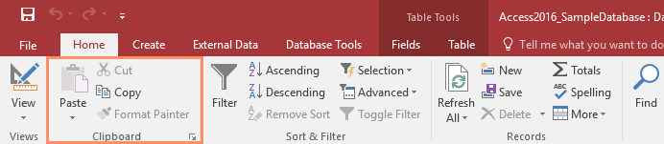
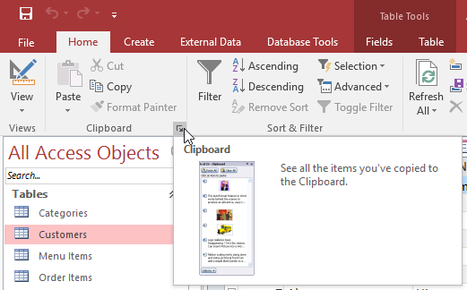
The Ribbon
Access uses a tabbed Ribbon system instead of traditional menus. The Ribbon contains multiple tabs, each with several groups of commands. For example, the Clipboard group on the Home tab contains commands such as Cut, Copy, and Paste.
Some groups also have a small arrow in the bottom-right corner that you can click for even more options.

Slide 10
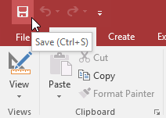
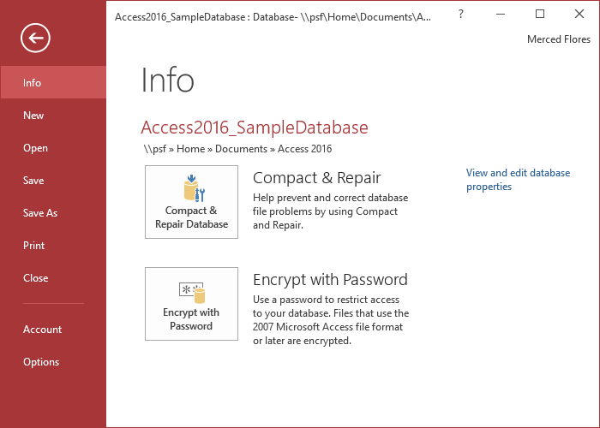
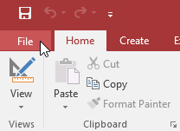
The Quick Access Toolbar
The Quick Access Toolbar, located above the Ribbon, lets you access common commands no matter which tab you are on. By default, it shows the Save, Undo, and Redo commands. If you'd like, you can customize it by adding additional commands.
Backstage view
Backstage view gives you various options for saving, opening, and printing your database.
To access Backstage view:
Click the File tab on the Ribbon.
Backstage view will appear.

Slide 11
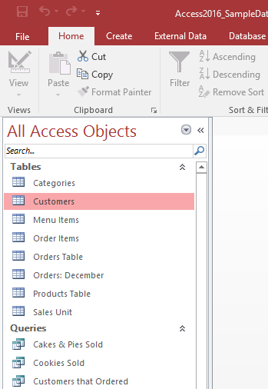
The Navigation pane
The Navigation pane is a list containing every object in your database. For easier viewing, the objects are organized into groups by type. You can open, rename, and delete objects using the Navigation pane.
Object sorting in the Navigation pane
  By default, objects are sorted by type, with tables in one group, forms in another, and so on. However, if you want you can sort the objects in the Navigation pane into groups of your choosing. There are four sort options:
Custom allows you to create a custom group for sorting objects. After applying the sort, simply drag the desired objects to the new group.
Object Type groups objects by type. This is the default setting.
Tables and Related Views groups forms, queries, and reports with the tables they refer to.
Created Date or Modified Date sorts objects based on when they were created or last edited.

Slide 12
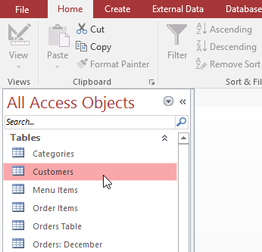
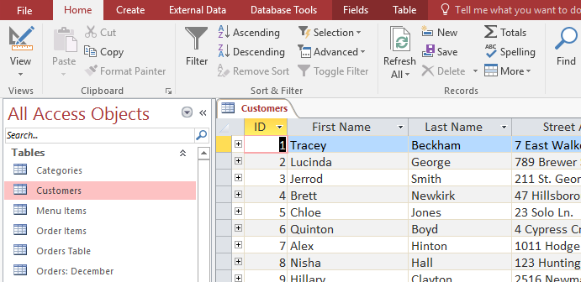
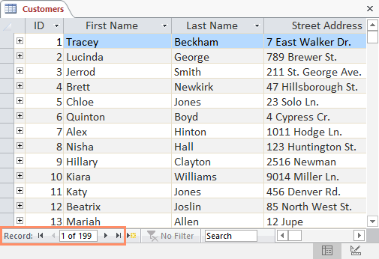
Working with Tables
To open an existing table:
Open your database, and locate the Navigation pane.
In the Navigation pane, locate the table you want to open.
Double-click the desired table.
The table will open and appear as a tab in the Document Tabs bar.
All tables are composed of horizontal rows and vertical columns, with small rectangles called cells in the places where rows and columns intersect. In Access, rows and columns are referred to as records and fields.
To navigate through records in a table, you can use the up and down arrow keys, scroll up and down, or use the arrows in the Record Navigation bar located at the bottom of your table.

Slide 13
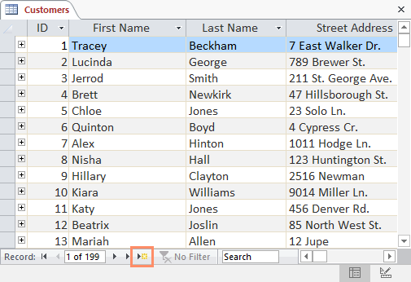
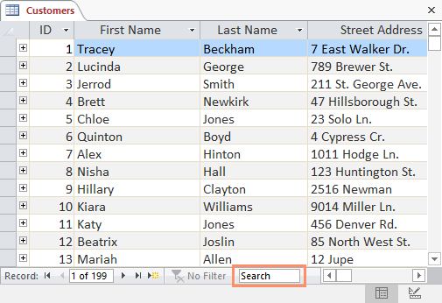
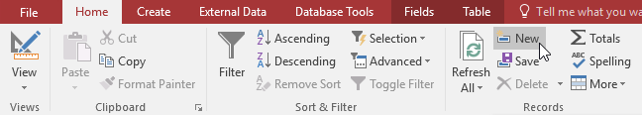
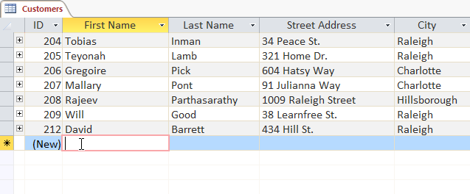
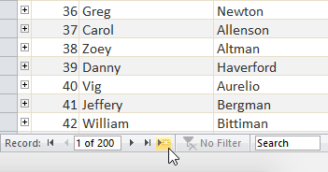
Tables Cont.
You can create a new record with the new (blank) record command on the Record Navigation bar.
You can find any record in the currently open table by searching for it using the record search box. Place your cursor in the search box, type any word that appears in the record you want to find, and press the Enter key.
To navigate between fields, you can use the left and right arrow keys or scroll left and right.
To add a new record There are 3 ways:
In the Records group on the Home tab, click the New command.
On the Record Navigation bar at the bottom of the window, click the New record button.
Begin typing in the row below your last added record.

Slide 14

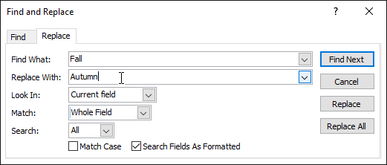
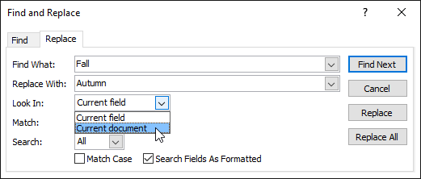
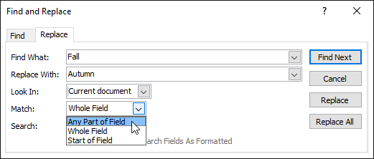
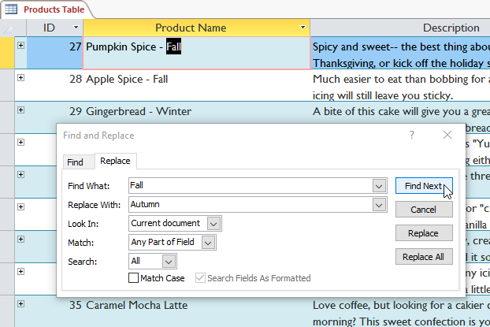
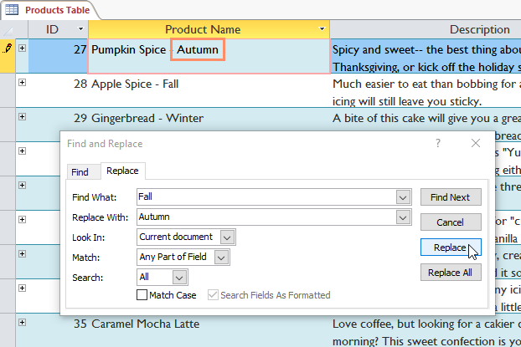
Tables Cont.
To replace a word within a record:
Select the Home tab, and locate the Find group.
Select the Replace command. The Find and Replace dialog box will appear.
In the Find What: field, type the word you want to find, then in the Replace With: field type the word you want to replace the original word. In our example, we'll find instances of the word Fall and replace it with Autumn.
Click the Look In: drop-down arrow to select the area you want to search. Select Current Field to limit your search to the currently selected field. Select Current Document to search within the entire table.
Click the Match: drop-down arrow to select how closely you'd like results to match your search. Select Any Part of Field to search for your search term in any part of a cell. Select Whole Field to search only for cells that match your search term exactly. Select Beginning of Field to search only for cells that start with your search term.
Click Find Next. If the text is found, it will be selected.
Review the text to make sure you want to replace it. Click Replace to replace the original word with the new one.

Slide 15
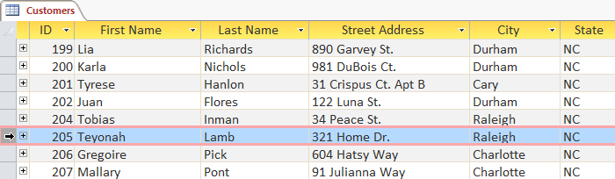
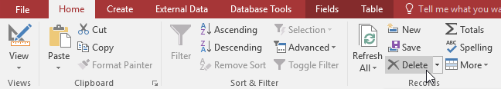
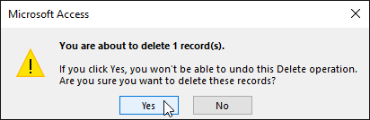
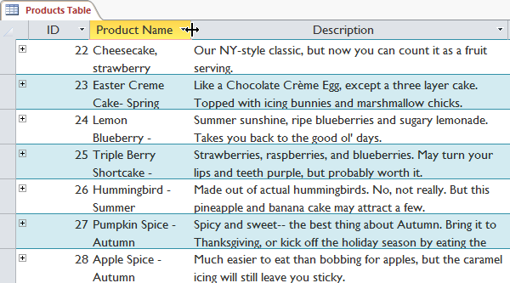
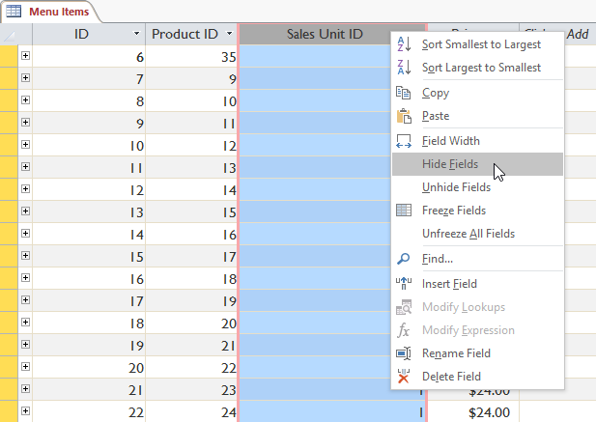
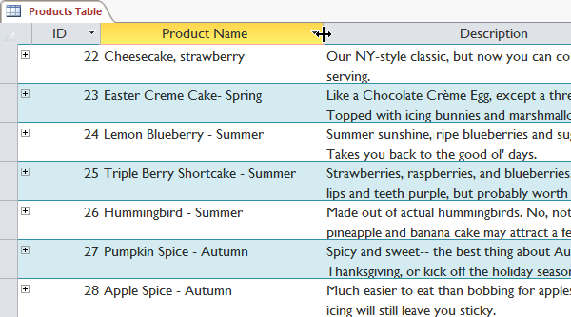
Tables Cont.
To delete a record:
Select the entire record by clicking the gray border on the left side of the record.
Select the Home tab and locate the Records group.
Click the Delete command.
A dialog box will appear. Click Yes.
The record will be permanently deleted.
ــــــــــــــــــــــــــــــــــــــــــــــــــــــــــــــــــــــــــــــــــــــــــــــــــــــــــــــــــــــــــــــــــ
To resize a field:
To hide a field:
Place your cursor over the right gridline in the field title. Your mouse will become a double arrow.
Click and drag the gridline to the right to increase the field width or to the left to decrease the field width, then release the mouse. The field width will be changed.
Right-click the field title, then select Hide Fields.

Slide 16
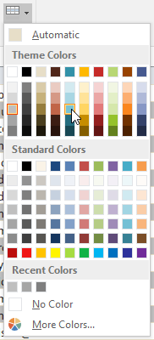
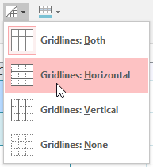


Tables Cont.
Alternate row color
Alternate row color
By default, the background of every other row in an Access table is a few shades darker than the background of the rest of the table. This darker alternate row color makes your table easier to read by offering a visual distinction between each record and the records directly above and below it.
By default, the background of every other row in an Access table is a few shades darker than the background of the rest of the table. This darker alternate row color makes your table easier to read by offering a visual distinction between each record and the records directly above and below it.
To change the alternate row color:
To customize which gridlines appear:
Select the Home tab, locate the Text Formatting group, and click the Alternate Row Color drop-down arrow.
Select a color from the drop-down menu, or select No Color to remove the alternate row color.
Select the Home tab, locate the Text Formatting group, and click the Gridlines drop-down arrow.
Select the gridlines you want to appear. You can choose to have horizontal gridlines between the rows, vertical gridlines between the columns, both types of gridlines, or none at all.

Slide 17
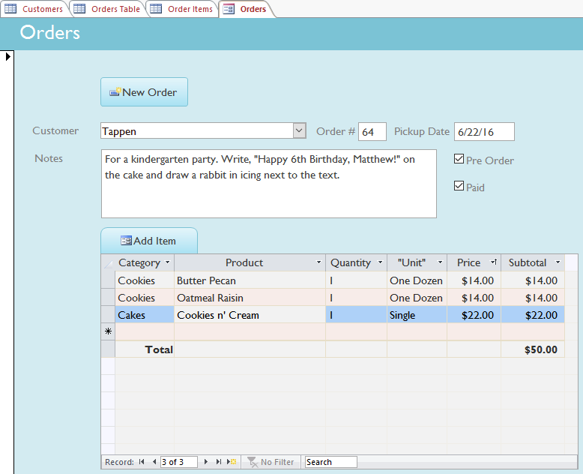
Working with Forms
Why use forms?
Many of us fill out forms so often that we hardly notice when we're asked to use them. Forms are so popular because they're useful to the person asking for the information and to the person providing it. They are a way of requiring information in a specific format, which means the person filling out the form knows exactly which information to include and where to put it.
Not only do forms make the data entry process easier for the user, but they also keep the database itself working smoothly. With forms, database designers can control exactly how users are able to interact with the database. They can even set restrictions on individual form components to ensure all of the needed data is entered and that it's all entered in a valid format. This is useful because keeping data consistent and organized is essential for an accurate and powerful database.

Slide 18
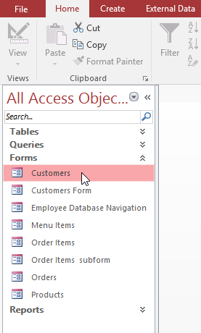
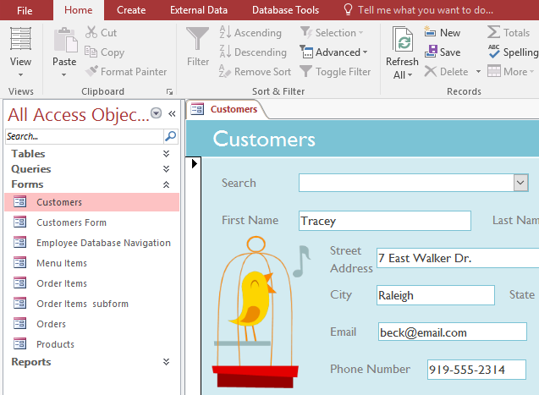
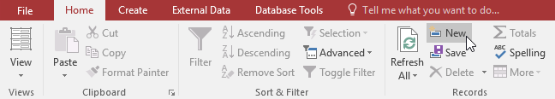

Forms Cont.
To open an existing form:
Open your database, and locate the Navigation pane.
In the Navigation pane, locate the form you want to open.
Double-click the desired form.
It will open and appear as a tab in the Document Tabs bar.
To add a new record:
On the Record Navigation bar at the bottom of the window, click the New Record button.
In the Records group on the Home tab of the Ribbon, click the New command.

Slide 19
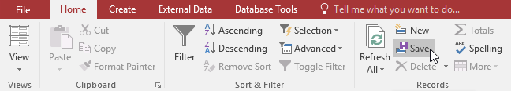
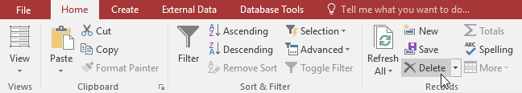



Forms Cont.
To save the current record:
Select the Home tab and locate the Records group.
Click the Save command. The current record will be saved.
To delete the current record:
Select the Home tab and locate the Records group.
Click the Delete command.
A dialog box will appear. Click Yes.
The record will be permanently deleted.
To find an existing record to view or edit:
To look through records one at a time, click the navigation arrows. The right arrow will take you to the next record, and the left arrow will take you to the previous one.
To search for a record, type a word you know is contained in that record in the navigation search box.

Slide 20
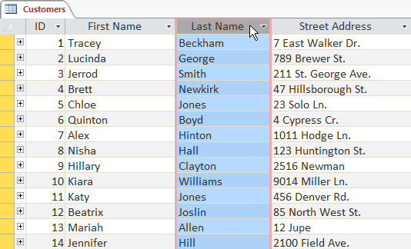
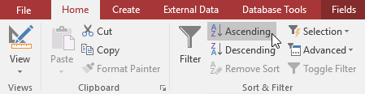
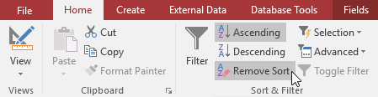
Sorting and Filtering Records
To sort records:
Select a field you want to sort by. In this example, we will sort by customers' last names.
Click the Home tab on the Ribbon, and locate the Sort & Filter group.
Sort the field by selecting the Ascending or Descending command.
The table will now be sorted by the selected field.
To save the new sort, click the Save command on the Quick Access Toolbar.
After you save the sort, the records will stay sorted this way until you perform another sort or remove the current one. To remove a sort, click the Remove Sort command.

Slide 21
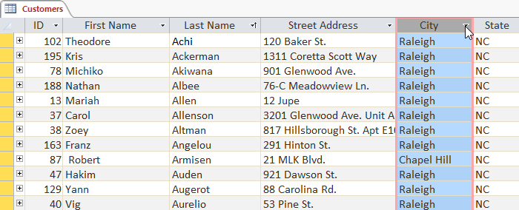
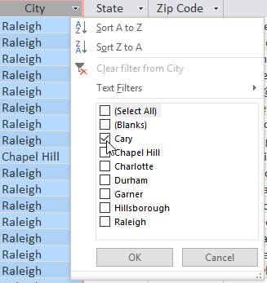
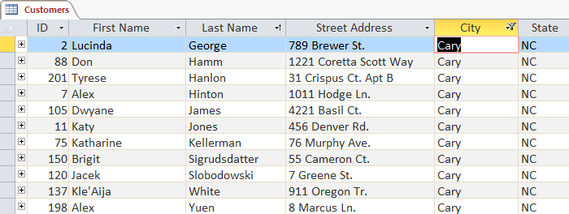
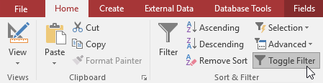
Sorting and Filtering Cont.
To create a simple filter:
Click the drop-down arrow next to the field you want to filter by. We will filter by city because we want to see a list of customers who live in a certain city.
A drop-down menu with a checklist will appear. Only checked items will be included in the filtered results. Clicking Select All will select or deselect everything at once. In our example, we'll deselect everything except Cary.
Click OK. The filter will be applied. Our customers table now displays only customers who live in Cary.
oggling your filter allows you to turn it on and off. To view the records without the filter, click the Toggle Filter command. To restore the filter, click it again.

Slide 22
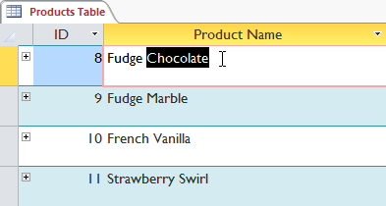
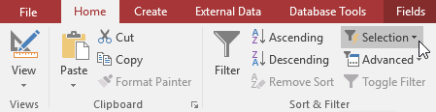


Sorting and Filtering Cont.
To create a simple filter:
Select the cell or data you want to create a filter with. We want to see a list of all of our products that contain the word chocolate in their names, so we'll select the word Chocolate in the Product Name field.
Select the Home tab on the Ribbon, locate the Sort & Filter group, and click the Selection drop-down arrow.
Select the type of filter you want to apply. We'll select Contains "Chocolate" because we want to see records that contain the word Chocolate anywhere in the field.
The filter will be applied. Our table now displays only products with the word Chocolate in their names.

Slide 23




Sorting and Filtering Cont.
To filter text by a search term:
Click the drop-down arrow next to the field you want to filter by. We want to filter the records in our orders table to display only those that contain notes with certain information, so we'll click the arrow in the Notes field.
In the drop-down menu, hover your mouse over Text Filters. From the list that appears, select the way you want the filter to match the term you enter. In this example, we want to view only records whose notes indicate the order was placed for a party. We'll select Contains so we can search for records that contain the word party.
The Custom Filter dialog box will appear. Type the word you want to use in your filter.
Click OK. The filter will be applied.

Slide 24



Sorting and Filtering Cont.
To filter numbers by a search term:
Click the drop-down arrow next to the field you want to filter by. We want to filter the records in our menu items table by price, so we'll click the arrow in the Price field.
In the drop-down menu, hover your mouse over Number Filters. From the list that appears, select the way you want the filter to match your search term. In this example, we want to see items that are less than $5, so we'll select Less Than.
The Custom Filter dialog box will appear. Type the number or numbers you want to use in your filter. We'll type 5 so the filter will show us only menu items that cost $5 or less.
Click OK. The filter will be applied.

Slide 25
What are queries?
Queries are a way of searching for and compiling data from one or more tables. Running a query is like asking a detailed question of your database. When you build a query in Access, you are defining specific search conditions to find exactly the data you want.
How are queries used?
Queries are far more powerful than the simple searches or filters you might use to find data within a table. This is because queries can draw their information from multiple tables. For example, while you could use a search in the customers table to find the name of one customer at your business or a filter on the orders table to view only orders placed within the past week, neither would let you view both customers and orders at once. However, you could easily run a query to find the name and phone number of every customer who's made a purchase within the past week. A well-designed query can give information you might not be able to find out just by examining the data in your tables.
When you run a query, the results are presented to you in a table, but when you design one you use a different view. This is called Query Design view, and it lets you see how your query is put together.

Slide 26



Queries Cont.
To create a simple one-table query:
Select the Create tab on the Ribbon, and locate the Queries group.
Click the Query Design command.
Access will switch to Query Design view. In the Show Table dialog box that appears, select the table you want to run a query on. We are running a query on our customers, so we'll select the Customers table.
Click Add, then click Close.
The selected table will appear as a small window in the Object Relationship pane. In the table window, double-click the field names you want to include in your query. They will be added to the design grid in the bottom part of the screen. In our example, we want to mail invitations to customers who live in a certain area, so we'll include the First Name, Last Name, Street Address, City, and Zip Code fields.

Slide 27



Queries Cont.
To create a simple one-table query:
Set the search criteria by clicking the cell in the Criteria: row of each field you want to filter. Typing criteria into more than one field in the Criteria: row will set your query to include only results that meet all criteria. If you want to set multiple criteria but don't need the records shown in your results to meet all of them, type the first criteria in the Criteria: row and additional criteria in the or: row and the rows beneath it. Because we want to find customers who either live in Raleigh or in the 27513 zip code, we'll type "Raleigh" in the City field and "27513" into the or: row of the Zip Code field. The quotation marks will search these fields for an exact match.
After you have set your criteria, run the query by clicking the Run command on the Design tab.
The query results will be displayed in the query's Datasheet view, which looks like a table. If you want, save your query by clicking the Save command in the Quick Access Toolbar. When prompted to name it, type the desired name, then click OK.

Slide 28



Queries Cont.
To create a multi-table query:
Select the Query Design command from the Create tab on the Ribbon.
In the dialog box that appears, select each table you want to include in your query and click Add. You can press and hold the Ctrl key on your keyboard to select more than one table. When we planned our query, we decided we needed information from the Customers and Orders tables, so we'll add these.
After you have added all of the tables you want, click Close.
The tables will appear in the Object Relationship pane, linked by a join line. Double-click the thin section of the join line between two tables to edit its join direction.

Slide 29



Queries Cont.
To create a multi-table query:
The Join Properties dialog box will appear. Select an option to choose the direction of your join. In our example, we'll choose option 3 because we want a right-to-left join.
In the table windows, double-click the field names you want to include in your query. They will be added to the design grid in the bottom part of the screen. In our example, we'll include most of the fields from the Customers table: First Name, Last Name, Street Address, City, State, Zip Code, and Phone Number. We'll also include the ID number from the Orders table.
Set field criteria by entering the desired criteria in the criteria row of each field. We want to set two criteria: Not in ("Raleigh") in the City field, and Like ("919*") in the Phone Number field. This will find customers who do not live in Raleigh but who do live in the 919 area code.

Slide 30


Queries Cont.
To create a multi-table query:
After you have set your criteria, run the query by clicking the Run command on the Design tab.
The query results will be displayed in the query's Datasheet view, which looks like a table. If you want, save your query by clicking the Save command in the Quick Access Toolbar. When prompted to name it, type the desired name, then click OK.

Slide 31




Reports
To create a report:
Open the table or query you want to use in your report. We want to print a list of cookies we've sold, so we'll open the Cookies Sold query.
Select the Create tab on the Ribbon. Locate the Reports group, then click the Report command.
Access will create a new report based on your object.
It's likely that some of your data will be located on the other side of the page break. To fix this, resize your fields. Simply select a field, then click and drag its edge until the field is the desired size. Repeat with additional fields until all of your fields fit.
To save your report, click the Save command on the Quick Access Toolbar. When prompted, type a name for your report, then click OK.

Slide 32




Reports
To delete a field in a report:
Click any cell in the field you want to delete, then press the Delete key on your keyboard.
The field will be deleted.
To print a report:
From the Home tab, click the View command, then select Print Preview from the drop-down list. Your report will be shown as it will appear on the printed page.
If necessary, modify the page size, margin width, and page orientation using the related commands on the Ribbon.
Click the Print command.
The Print dialog box will appear. Set any desired print options, then click OK. The report will be printed.

Slide 33


Reports
To export a report:
From the Home tab, click the View command, then select Print Preview from the drop-down list.
Locate the Data group on the Ribbon.
Select one of the file type options, or click More to see options to save your report as a Word or HTML file.
A dialog box will appear. Select the location where you want to save the report.
Enter a file name for the report, then click Publish.
A dialog box will appear to notify you that your file has been successfully saved. Click Close to return to your report.

Slide 35


