Slide 1

ICDL COURSE
Lecture 4

Slide 2



Welcome To Microsoft Excel 2016

Slide 3

Microsoft Excel
Excel is a spreadsheet program that allows you to store, organize, and analyze information. While you may believe Excel is only used by certain people to process complicated data, anyone can learn how to take advantage of the program's powerful features. Whether you're keeping a budget, organizing a training log, or creating an invoice, Excel makes it easy to work with different types of data.
Excel 2016 allows you to store,
organize, and analyze information.

Slide 4
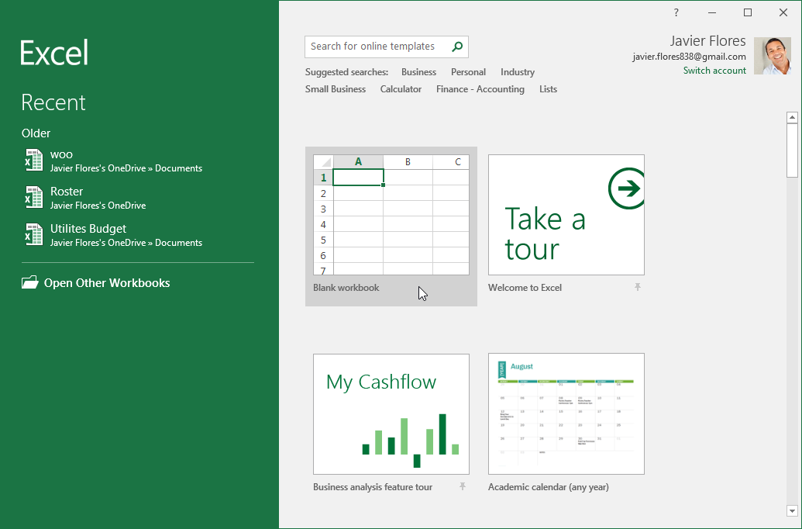
Excel Interface
When you open Excel 2016 for the first time, the Excel Start Screen will appear. From here, you'll be able to create a new workbook, choose a template, and access your recently edited workbooks.
From the Excel Start Screen, locate and select Blank workbook to access the Excel interface.

Slide 5
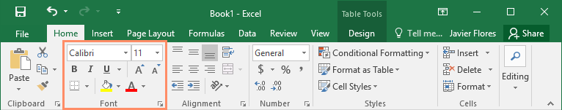
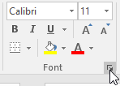
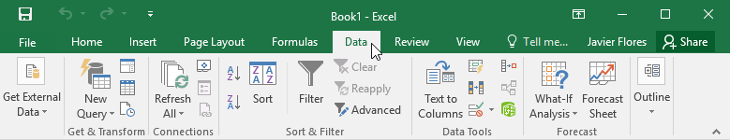
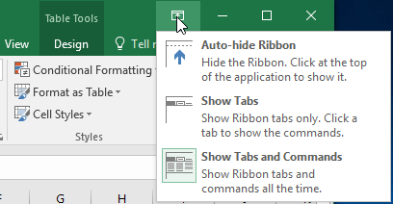
The Ribbon
Excel 2016 uses a tabbed Ribbon system instead
of traditional menus. The Ribbon contains multiple tabs, each with several groups of commands. You will use these tabs to perform the most common tasks in Excel.
Each tab will have one or more groups.
Some groups will have an arrow you can click for more options.
Click a tab to see more commands.
You can adjust how the Ribbon is displayed with the Ribbon Display Options.

Slide 6
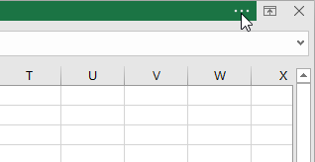
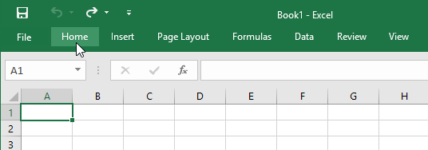
To change the Ribbon Display Options
The Ribbon is designed to respond to your current task, but you can choose to minimize it if you find that it takes up too much screen space. Click the Ribbon Display Options arrow in the upper-right corner of the Ribbon to display the drop-down menu.
There are three modes in the Ribbon Display Options menu:
Auto-hide Ribbon: Auto-hide displays your workbook in full-screen mode and completely hides the Ribbon. To show the Ribbon, click the Expand Ribbon command at the top of screen.
Show Tabs: This option hides all command groups when they're not in use, but tabs will remain visible. To show the Ribbon, simply click a tab.
Show Tabs and Commands: This option maximizes the Ribbon. All of the tabs and commands will be visible. This option is selected by default when you open Excel for the first time.

Slide 7
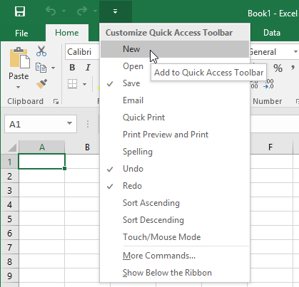
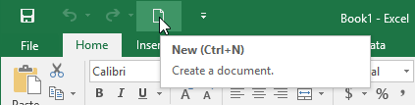
The Quick Access Toolbar
Located just above the Ribbon, the Quick Access Toolbar lets you access common commands no matter which tab is selected. By default, it includes the Save, Undo, and Repeat commands. You can add other commands depending on your preference.
To add Commands to the Quick Access Toolbar:
Click the drop-down arrow to the right of the Quick Access Toolbar.
Select the command you want to add from the drop-down menu. To choose from more commands, select More Commands.
The command will be added to the Quick Access Toolbar.

Slide 8
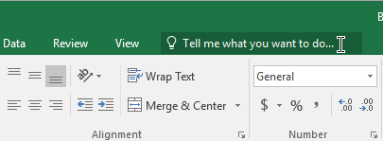
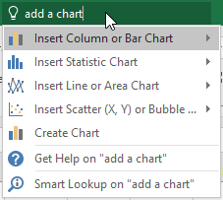
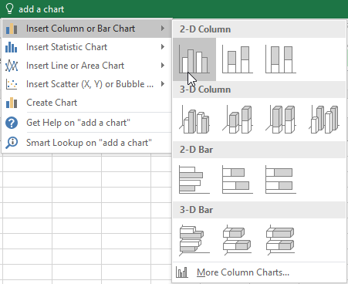
Using the Tell me feature
The Tell me box works like a search bar to help you quickly find tools or commands you want to use.
Type in your own words what you want to do.
The results will give you a few relevant options. To use one, click it like you would a command on the Ribbon.

Slide 9

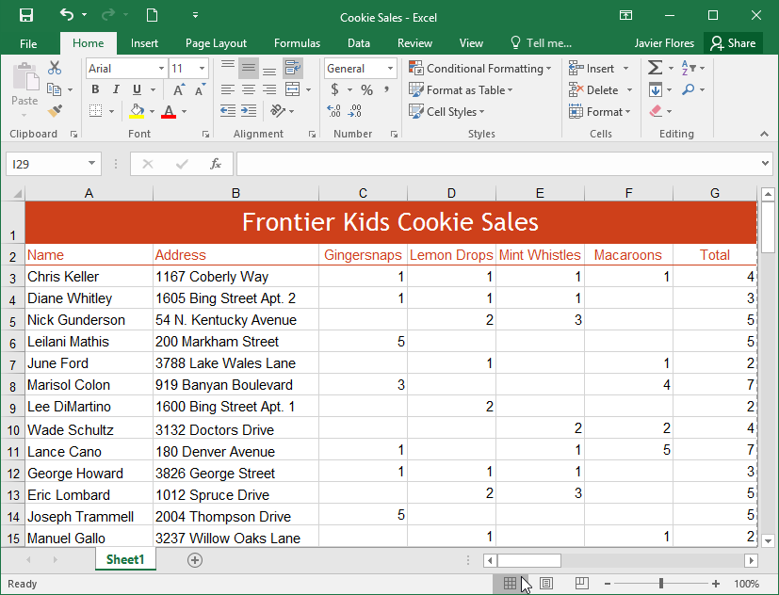
Worksheet views
Excel 2016 has a variety of viewing options that change how your workbook is displayed. These views can be useful for various tasks, especially if you're planning to print the spreadsheet. To change worksheet views, locate the commands in the bottom-right corner of the Excel window and select Normal view, Page Layout view, or Page Break view.
Normal view is the default view for all worksheets in Excel.

Slide 10
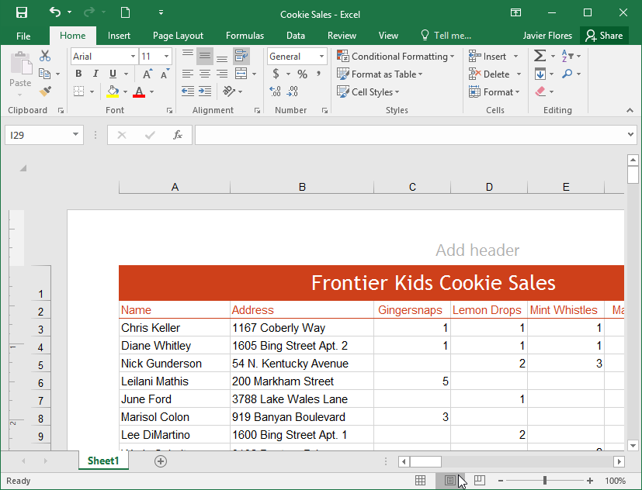
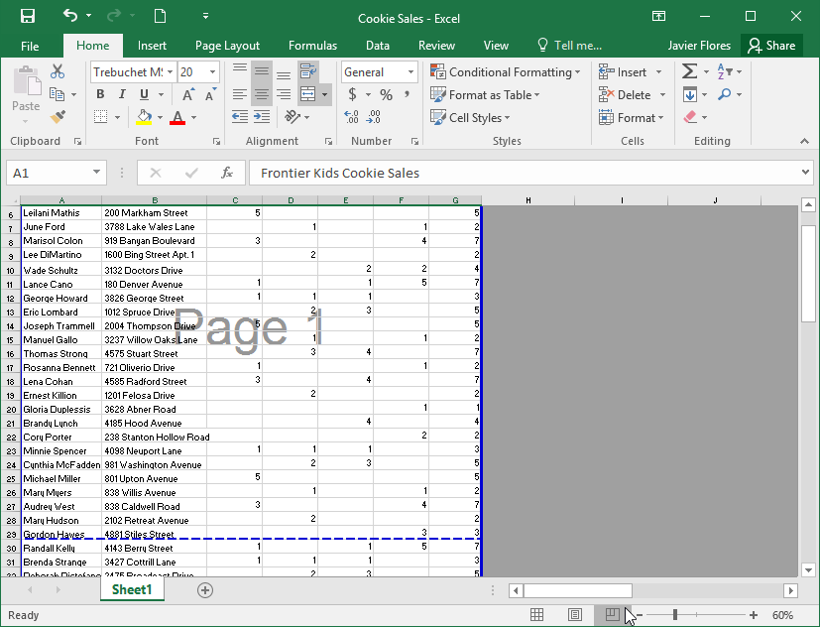
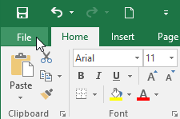
Worksheet views(Cont.)
Page Layout view displays how your worksheets will appear when printed. You can also add headers and footers in this view.
Page Break view allows you to change the location of page breaks, which is especially helpful when printing a lot of data from Excel.
To access Backstage view:
  Click the File tab on the Ribbon. Backstage view will appear.

Slide 11
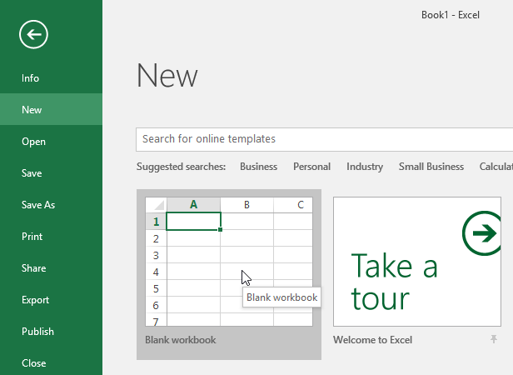
To create a new blank workbook
Select the File tab. Backstage view will appear.
Select New, then click Blank workbook.
A new blank workbook will appear.

Slide 12
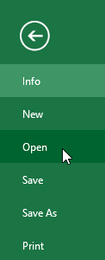
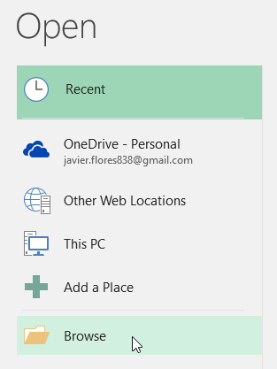
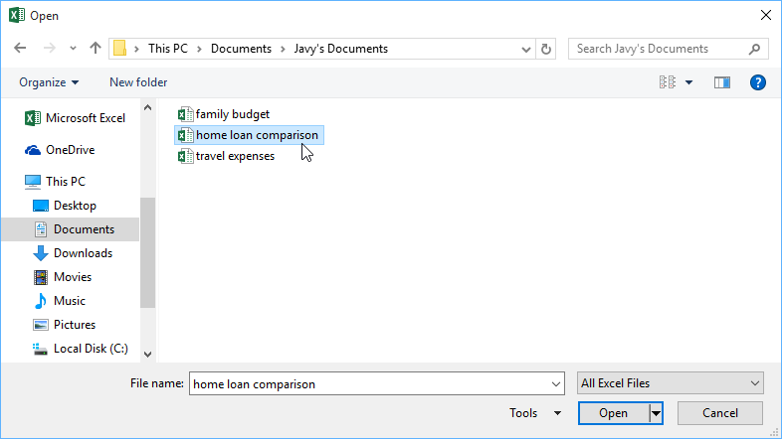
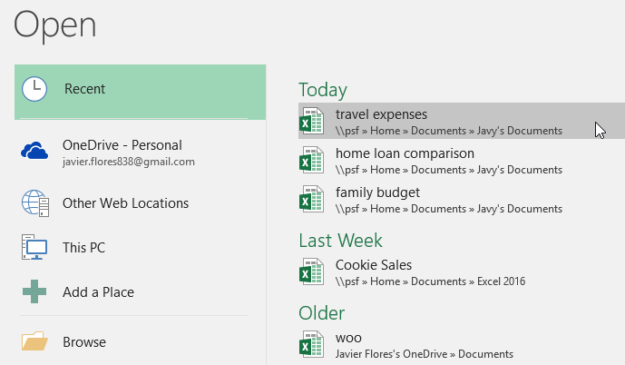
To open an existing workbook
Navigate to Backstage view, then click Open.
Select Computer, then click Browse. Alternatively, you can choose OneDrive to open files stored on your OneDrive.
The Open dialog box will appear. Locate and select your workbook, then click Open.
If you've opened the desired workbook recently, you can browse your Recent Workbooks rather than search for the file.

Slide 13
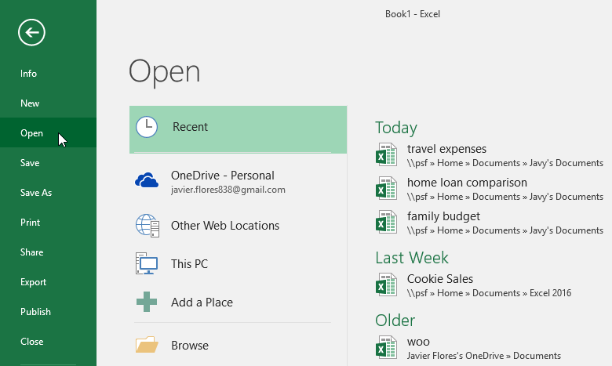
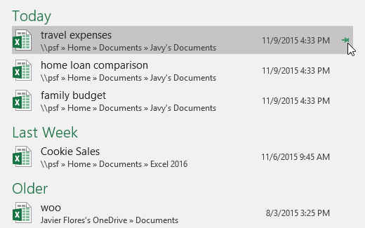
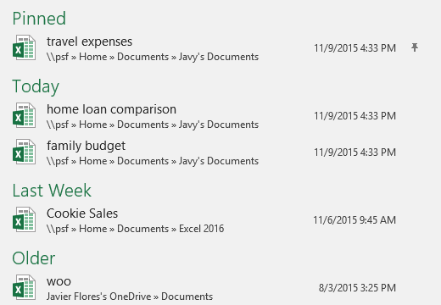
To pin a workbook
Navigate to Backstage view, then click Open. Your recently edited workbooks will appear.
Hover the mouse over the workbook you want to pin. A pushpin icon will appear next to the workbook. Click the pushpin icon.
The workbook will stay in Recent Workbooks. To unpin a workbook, simply click the pushpin icon again.

Slide 14
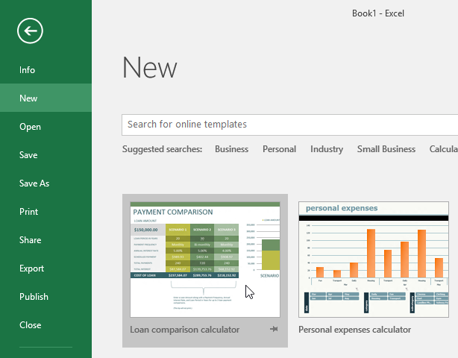
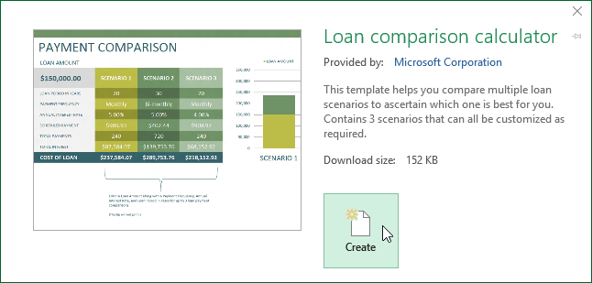
To create a new workbook from a template
Click the File tab to access Backstage view.
Select New. Several templates will appear below the Blank workbook option.
Select a template to review it.
A preview of the template will appear, along with additional information on how the template can be used.
Click Create to use the selected template.
A new workbook will appear with the selected template.

Slide 15
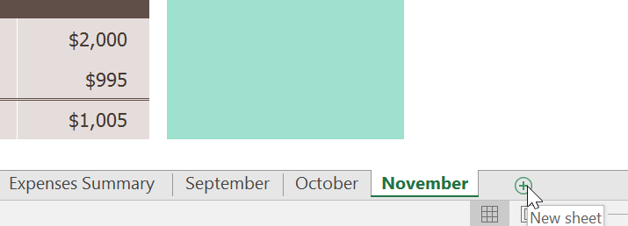
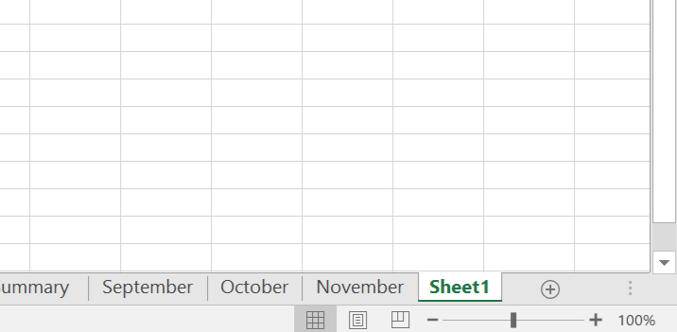
To insert a new worksheet:
Locate and select the New sheet button near the bottom-right corner of the Excel window.
A new blank worksheet will appear.
To copy a worksheet:
Right-click the worksheet you want to copy, then select Move or Copy from the worksheet menu.
The Move or Copy dialog box will appear. Choose where the sheet will appear in the Before sheet: field. In our example, we'll choose (move to end) to place the worksheet to the right of the existing worksheet.
Check the box next to Create a copy, then click OK.
The worksheet will be copied. It will have the same title as the original worksheet, as well as a version number. In our example, we copied the November worksheet, so our new worksheet is named November (2). All content from the November worksheet has also been copied to the new worksheet.

Slide 16
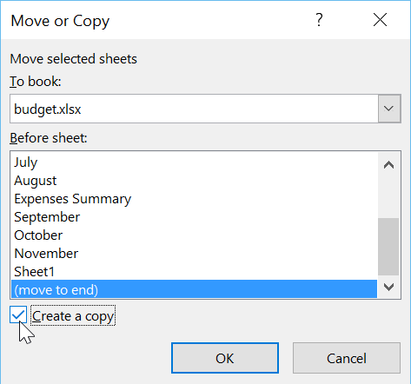
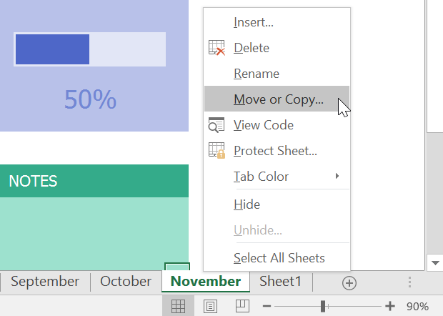
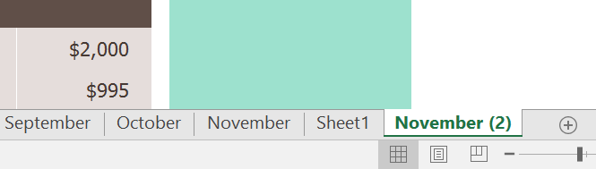
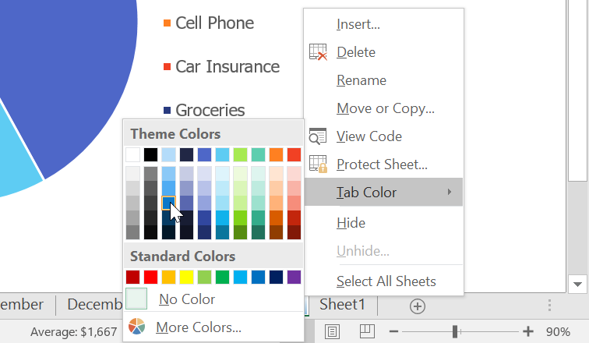
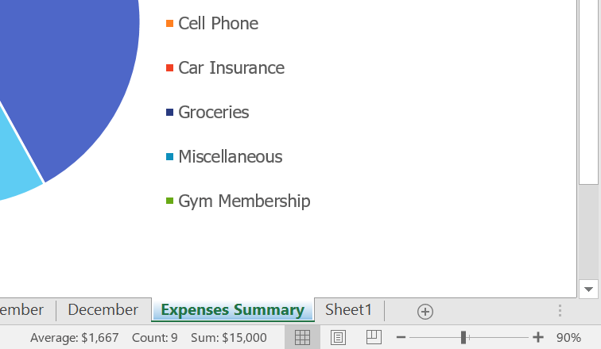
To change the worksheet tab color:
Right-click the desired worksheet tab, and hover the mouse over Tab Color. The Color menu will appear.
Select the desired color.
The worksheet tab color will be changed.

Slide 17
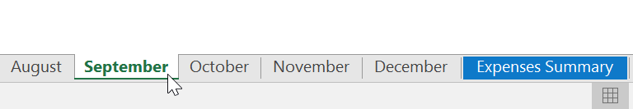
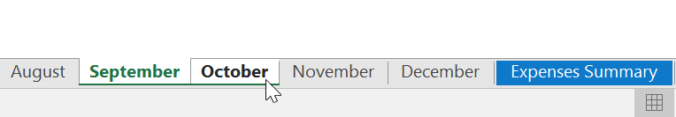
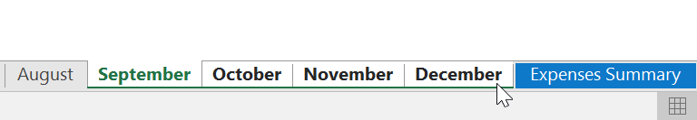
To group worksheets:
Select the first worksheet you want to include in the worksheet group.
Press and hold the Ctrl key on your keyboard. Select the next worksheet you want in the group.
Continue to select worksheets until all of the worksheets you want to group are selected, then release the Ctrl key. The worksheets are now grouped.

Slide 18
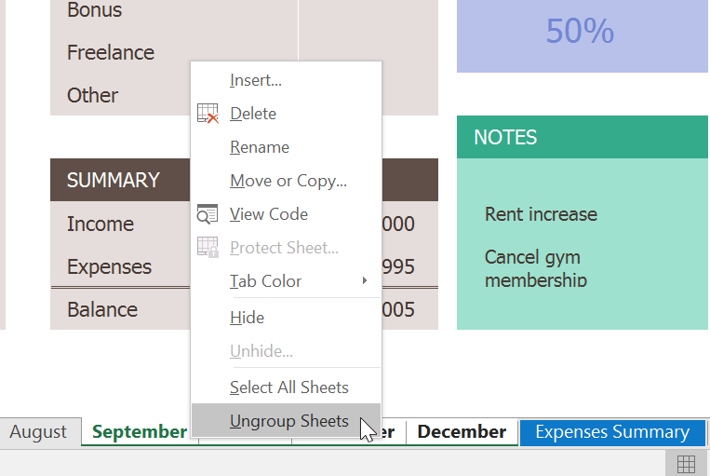
To ungroup worksheets:
Right-click a worksheet in the group, then select Ungroup Sheets from the worksheet menu.
The worksheets will be ungrouped. Alternatively, you can simply click any worksheet not included in the group to ungroup all worksheets.

Slide 19
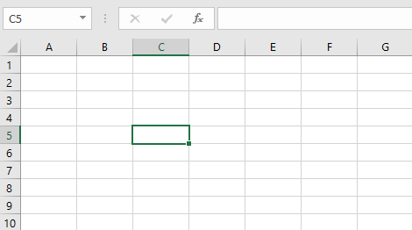
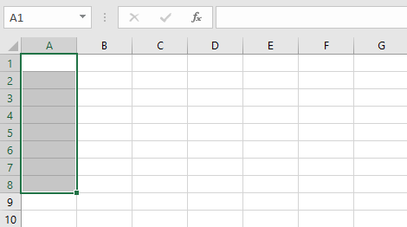
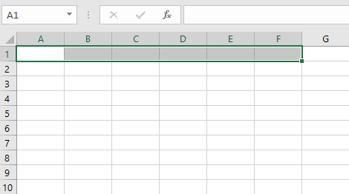
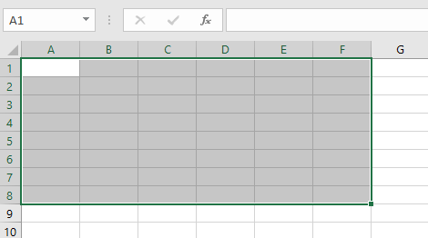
Understanding cells
Every worksheet is made up of thousands of rectangles, which are called cells. A cell is the intersection of a row and a column—in other words, where a row and column meet.
Columns are identified by letters (A, B, C), while rows are identified by numbers (1, 2, 3). Each cell has its own name—or cell address—based on its column and row. In the example below, the selected cell intersects column C and row 5, so the cell address is C5.
Note that the cell address also appears in the Name box in the top-left corner, and that a cell's column and row headings are highlighted when the cell is selected.
You can also select multiple cells at the same time. A group of cells is known as a cell range. Rather than a single cell address, you will refer to a cell range using the cell addresses of the first and last cells in the cell range, separated by a colon. For example, a cell range that included cells A1, A2, A3, A4, and A5 would be written as A1:A5. Take a look at the different cell ranges below:
Cell range A1:A8
Cell range A1:A8
Cell range A1:A8

Slide 20
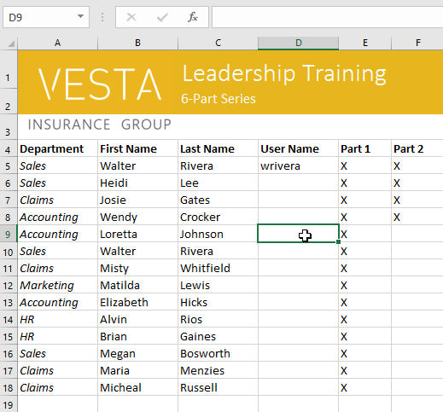
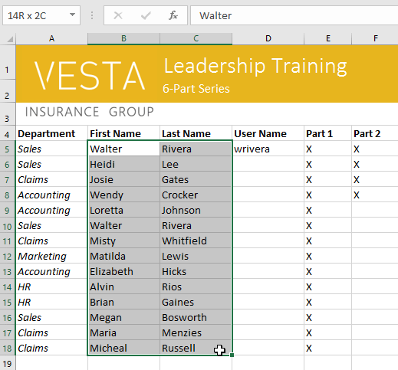
To select a cell:
Click a cell to select it. In our example, we'll select cell D9.
A border will appear around the selected cell, and the column heading and row heading will be highlighted. The cell will remain selected until you click another cell in the worksheet.
To select a cell range:
Click and drag the mouse until all of the adjoining cells you want to select are highlighted. In our example, we'll select the cell range B5:C18.
Release the mouse to select the desired cell range. The cells will remain selected until you click another cell in the worksheet.

Slide 21
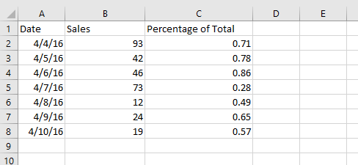
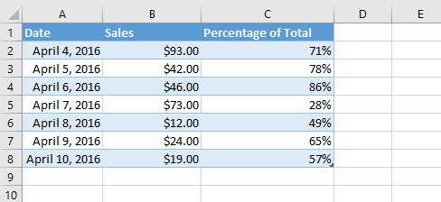
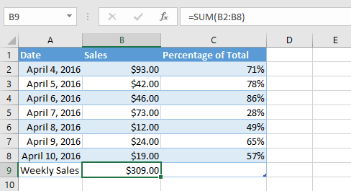
Cell content:
Any information you enter into a spreadsheet will be stored in a cell. Each cell can contain different types of content, including text, formatting, formulas, and functions.
Text: Cells can contain text, such as letters, numbers, and dates.
Formatting attributes: Cells can contain formatting attributes that change the way letters, numbers, and dates are displayed. For example, percentages can appear as 0.15 or 15%. You can even change a cell's text or background color.
Formulas and functions: Cells can contain formulas and functions that calculate cell values. In our example, SUM(B2:B8) adds the value of each cell in the cell range B2:B8 and displays the total in cell B9.

Slide 22
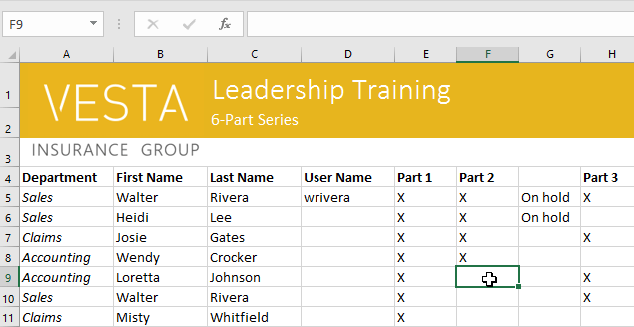
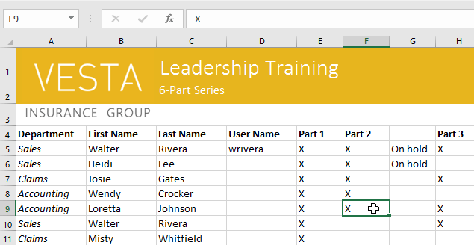
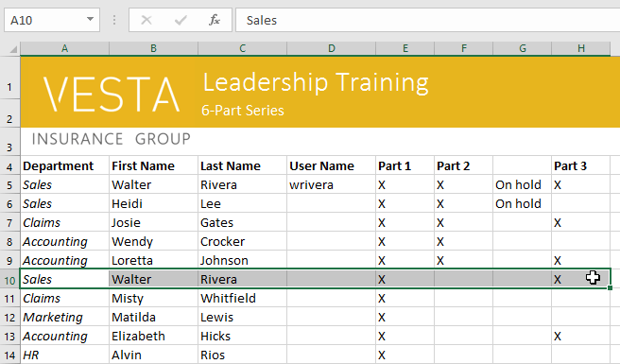
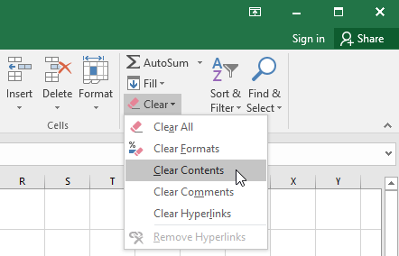

To insert content:
Click a cell to select it. In our example, we'll select cell F9.
Type something into the selected cell, then press Enter on your keyboard. The content will appear in the cell and the formula bar. You can also input and edit cell content in the formula bar.
To delete (or clear) cell content:
Select the cell(s) with content you want to delete. In our example, we'll select the cell range A10:H10.
Select the Clear command on the Home tab, then click Clear Contents.
The cell contents will be deleted.

Slide 23



To delete cells:
Select the cell(s) you want to delete. In our example, we'll select A10:H10.
Select the Delete command from the Home tab on the Ribbon.
The cells below will shift up and fill in the gaps.

Slide 24





To copy and paste cell content:
Select the cell(s) you want to copy. In our example, we'll select F9.
Click the Copy command on the Home tab, or press Ctrl+C on your keyboard.
Select the cell(s) where you want to paste the content. In our example, we'll select F12:F17. The copied cell(s) will have a dashed box around them.
Click the Paste command on the Home tab, or press Ctrl+V on your keyboard.
The content will be pasted into the selected cells.

Slide 25



To drag and drop cells:
Select the cell(s) you want to move. In our example, we'll select H4:H12.
Hover the mouse over the border of the selected cell(s) until the mouse changes to a pointer with four arrows.
Click and drag the cells to the desired location. In our example, we'll move them to G4:G12.
Release the mouse. The cells will be dropped in the selected location.

Slide 26



To use the fill handle:
Select the cell(s) containing the content you want to use, then hover the mouse over the lower-right corner of the cell so the fill handle appears.
Click and drag the fill handle until all of the cells you want to fill are selected. In our example, we'll select G13:G17.
Release the mouse to fill the selected cells.

Slide 27


To continue a series with the fill handle:
Select the cell range that contains the series you want to continue. In our example, we'll select E4:G4.
Click and drag the fill handle to continue the series.
Release the mouse. If Excel understood the series, it will be continued in the selected cells. In our example, Excel added Part 4, Part 5, and Part 6 to H4:J4.

Slide 28



To modify column width:
Position the mouse over the column line in the column heading so the cursor becomes a double arrow.
Click and drag the mouse to increase or decrease the column width.
Release the mouse. The column width will be changed.

Slide 29



To AutoFit column width:
Position the mouse over the column line in the column heading so the cursor becomes a double arrow.
Double-click the mouse. The column width will be changed automatically to fit the content.
You can also AutoFit the width for several columns at the same time. Simply select the columns you want to AutoFit, then select the AutoFit Column Width command from the Format drop-down menu on the Home tab. This method can also be used for row height.

Slide 30



To modify row height:
Position the cursor over the row line so the cursor becomes a double arrow.
Click and drag the mouse to increase or decrease the row height.
Release the mouse. The height of the selected row will be changed.

Slide 31


To modify row height:
Locate and click the Select All button just below the name box to select every cell in the worksheet.
Position the mouse over a row line so the cursor becomes a double arrow.
Click and drag the mouse to increase or decrease the row height, then release the mouse when you are satisfied. The row height will be changed for the entire worksheet.

Slide 32




To insert rows:
Select the row heading below where you want the new row to appear. In this example, we want to insert a row between rows 4 and 5, so we'll select row 5.
Click the Insert command on the Home tab.
The new row will appear above the selected row.
When inserting new rows, columns, or cells, you will see a paintbrush icon next to the inserted cells. This button allows you to choose how Excel formats these cells. By default, Excel formats inserted rows with the same formatting as the cells in the row above. To access more options, hover your mouse over the icon, then click the drop-down arrow.
Use the same steps to insert columns

Slide 33




To delete a row or column:
Select the row you want to delete. In our example, we'll select row 9.
Click the Delete command on the Home tab.
The selected row will be deleted, and those around it will shift. In our example, row 10 has moved up, so it's now row 9.
It's important to understand the difference between deleting a row or column and simply clearing its contents. If you want to remove the content from a row or column without causing others to shift, right-click a heading, then select Clear Contents from the drop-down menu.

Slide 34



To merge cells using the Merge & Center command:
Select the cell range you want to merge. In our example, we'll select A1:F1.
Click the Merge & Center command on the Home tab. In our example, we'll select the cell range A1:F1.
The selected cells will be merged, and the text will be centered.
To access more merge options:
Merge & Center: merges the selected cells into one cell and centers the text
Merge Across: merges the selected cells into larger cells while keeping each row separate
Merge Cells: merges the selected cells into one cell but does not center the text
Unmerge Cells: unmerges selected cells

Slide 35



To center across selection:
Select the desired cell range. In our example, we'll select A1:F1. Note: If you already merged these cells, you should unmerge them before continuing to step 2.
Click the small arrow in the lower-right corner of the Alignment group on the Home tab.
A dialog box will appear. Locate and select the Horizontal drop-down menu, select Center Across Selection, then click OK.
The content will be centered across the selected cell range. As you can see, this creates the same visual result as merging and centering, but it preserves each cell within A1:F1.

Slide 36


To wrap text in cells:
Select the cells you want to wrap. In this example, we'll select the cells in column C.
Click the Wrap Text command on the Home tab.
The text in the selected cells will be wrapped.
Click the Wrap Text command again to unwrap the text.

Slide 37




To hide and unhide a row or column:
Select the columns you want to hide, right-click the mouse, then select Hide from the formatting menu. In our example, we'll hide columns C, D, and E.
The columns will be hidden. The green column line indicates the location of the hidden columns.
To unhide the columns, select the columns on both sides of the hidden columns. In our example, we'll select columns B and F. Then right-click the mouse and select Unhide from the formatting menu.
The hidden columns will reappear.

Slide 38





To move a row or column:
Select the desired column heading for the column you want to move.
Click the Cut command on the Home tab, or press Ctrl+X on your keyboard.
Select the column heading to the right of where you want to move the column. For example, if you want to move a column between columns E and F, select column F.
Click the Insert command on the Home tab, then select Insert Cut Cells from the drop-down menu.
The column will be moved to the selected location, and the columns around it will shift.

Slide 39




Applying number formats
Go to the Home tab, click the Number Format drop-down menu in the Number group, and select the desired format.
You can also click one of the quick number-formatting commands below the drop-down menu.
You can also select the desired cells and press Ctrl+1 on your keyboard to access more number-formatting options.
In this example, we've applied the Currency number format, which adds currency symbols ($) and displays two decimal places for any numerical values.
In this example, we've applied the Currency number format, which adds currency symbols ($) and displays two decimal places for any numerical values.

Slide 40



Using number formats correctly
There's more to number formatting than selecting cells and applying a format. Spreadsheets can actually apply a lot of number formatting automatically based on the way you enter data. This means you'll need to enter data in a way the program can understand, and then ensure that those cells are using the proper number format. For example, the image below shows how to use number formats correctly for dates, percentages, and times:
Percentage formats
One of the most helpful number formats is the percentage (%) format. It displays values as percentages, such as 20% or 55%. This is especially helpful when calculating things like the cost of sales tax or a tip. When you type a percent sign (%) after a number, the percentage number format will be be applied to that cell automatically.
As you can see, the calculation in the spreadsheet on the left didn't work correctly. Without the percentage number format, our spreadsheet thinks we want to multiply $22.50 by 5, not 5%. And while the spreadsheet on the right still works without percentage formatting, the spreadsheet in the middle is easier to read.

Slide 41



Date formats
Now that we have our date correctly formatted, we can do many different things with this data. For example, we could use the fill handle to continue the dates through the column, so a different day appears in each cell:
Whenever you're working with dates, you'll want to use a date format to tell the spreadsheet that you're referring to specific calendar dates, such as July 15, 2014. Date formats also allow you to work with a powerful set of date functions that use time and date information to calculate an answer.
Spreadsheets don't understand information the same way a person would. For instance, if you type October into a cell, the spreadsheet won't know you're entering a date so it will treat it like any other text. Instead, when you enter a date, you'll need to use a specific format your spreadsheet understands, such as month/day/year (or day/month/year depending on which country you're in). In the example below, we'll type 10/12/2014 for October 12, 2014. Our spreadsheet will then automatically apply the date number format for the cell.

Slide 42



Other date formatting options :
If the date formatting isn't applied automatically, it means the spreadsheet did not understand the data you entered. In the example below, we've typed March 15th. The spreadsheet did not understand that we were referring to a date, so this cell is still using the general number format.
To access other date formatting options, select the Number Format drop-down menu and choose More Number Formats. These are options to display the date differently, like including the day of the week or omitting the year.
The Format Cells dialog box will appear. From here, you can choose the desired date formatting option.

Slide 43



Number formatting tips
Apply number formatting to an entire column: If you're planning to use one column for a certain type of data, like dates or percentages, you may find it easiest to select the entire column by clicking the column letter and applying the desired number formatting. This way, any data you add to this column in the future will already have the correct number format. Note that the header row usually won't be affected by number formatting.
Double-check your values after applying number formatting: If you apply number formatting to existing data, you may have unexpected results. For example, applying percentage (%) formatting to a cell with a value of 5 will give you 500%, not 5%. In this case, you'd need to retype the values correctly in each cell.
If you reference a cell with number formatting in a formula, the spreadsheet may automatically apply the same number formatting to the new cell. For example, if you use a value with currency formatting in a formula, the calculated value will also use the currency number format.

Slide 44



Increase and Decrease Decimal :
The Increase Decimal and Decrease Decimal commands allow you to control how many decimal places are displayed in a cell. These commands don't change the value of the cell; instead, they display the value to a set number of decimal places.
Decreasing the decimal will display the value rounded to that decimal place, but the actual value in the cell will still be displayed in the formula bar.
Mathematical operators
Excel uses standard operators for formulas, such as a plus sign for addition (+), a minus sign for subtraction (-), an asterisk for multiplication (*), a forward slash for division (/), and a caret (^) for exponents.

Slide 45





Understanding cell references
While you can create simple formulas in Excel using numbers (for example, =2+2 or =5*5), most of the time you will use cell addresses to create a formula. This is known as making a cell reference. Using cell references will ensure that your formulas are always accurate because you can change the value of referenced cells without having to rewrite the formula.
In the formula below, cell A3 adds the values of cells A1 and A2 by making cell references:
When you press Enter, the formula calculates and displays the answer in cell A3:
If the values in the referenced cells change, the formula automatically recalculates:
To create a formula:
Select the cell that will contain the formula. In our example, we'll select cell D12.
Type the equals sign (=). Notice how it appears in both the cell and the formula bar.

Slide 46



Type the cell address of the cell you want to reference first in the formula: cell D10 in our example. A blue border will appear around the referenced cell.
Type the mathematical operator you want to use. In our example, we'll type the addition sign (+).
Type the cell address of the cell you want to reference second in the formula: cell D11 in our example. A red border will appear around the referenced cell.
Press Enter on your keyboard. The formula will be calculated, and the value will be displayed in the cell. If you select the cell again, notice that the cell displays the result, while the formula bar displays the formula.
If the result of a formula is too large to be displayed in a cell, it may appear as pound signs (#######) instead of a value. This means the column is not wide enough to display the cell content. Simply increase the column width to show the cell content.

Slide 47



Modifying values with cell references
The true advantage of cell references is that they allow you to update data in your worksheet without having to rewrite formulas. In the example below, we've modified the value of cell D10 from $1,200 to $1,800. The formula in D12 will automatically recalculate and display the new value in cell D12.
To create a formula using the point-and-click method
Select the cell that will contain the formula. In our example, we'll select cell D4.
Type the equals sign (=).
Select the cell you want to reference first in the formula: cell B4 in our example. The cell address will appear in the formula.

Slide 48


Type the mathematical operator you want to use. In our example, we'll type the multiplication sign (*).
Select the cell you want to reference second in the formula: cell C4 in our example. The cell address will appear in the formula.
Press Enter on your keyboard. The formula will be calculated, and the value will be displayed in the cell.

Slide 49



Copying formulas with the fill handle
Formulas can also be copied to adjacent cells with the fill handle, which can save a lot of time and effort if you need to perform the same calculation multiple times in a worksheet. The fill handle is the small square at the bottom-right corner of the selected cell(s).
Select the cell containing the formula you want to copy. Click and drag the fill handle over the cells you want to fill.
After you release the mouse, the formula will be copied to the selected cells.
To edit a formula
Select the cell containing the formula you want to edit. In our example, we'll select cell D12.

Slide 50




Click the formula bar to edit the formula. You can also double-click the cell to view and edit the formula directly within the cell.
A border will appear around any referenced cells. In our example, we'll change the first part of the formula to reference cell D10 instead of cell D9.
When you're finished, press Enter on your keyboard or select the Enter command in the formula bar.
The formula will be updated, and the new value will be displayed in the cell.

Slide 51
Save and Save As
Excel offers two ways to save a file: Save and Save As. These options work in similar ways, with a few important differences:
Save: When you create or edit a workbook, you'll use the Save command to save your changes. You'll use this command most of the time. When you save a file, you'll only need to choose a file name and location the first time. After that, you can just click the Save command to save it with the same name and location.
Save As: You'll use this command to create a copy of a workbook while keeping the original. When you use Save As, you'll need to choose a different name and/or location for the copied version.
It's important to save your workbook whenever you start a new project or make changes to an existing one. Saving early and often can prevent your work from being lost. You'll also need to pay close attention to where you save the workbook so it will be easy to find later.

Slide 52



To save a workbook:
Locate and select the Save command on the Quick Access Toolbar.
If you're saving the file for the first time, the Save As pane will appear in Backstage view.
You'll then need to choose where to save the file and give it a file name. To save the workbook to your computer, select Computer, then click Browse. Alternatively, you can click OneDrive to save the file to your OneDrive.
The Save As dialog box will appear. Select the location where you want to save the workbook.
Enter a file name for the workbook, then click Save.
The workbook will be saved. You can click the Save command again to save your changes as you modify the workbook.

Slide 53

Using Save As to make a copy
If you want to save a different version of a workbook while keeping the original, you can create a copy. For example, if you have a file named Sales Data, you could save it as Sales Data 2 so you'll be able to edit the new file and still refer back to the original version.
To do this, you'll click the Save As command in Backstage view. Just like when saving a file for the first time, you'll need to choose where to save the file and give it a new file name.

Slide 54


To change the default save location
If you don't want to use OneDrive, you may be frustrated that OneDrive is selected as the default location when saving. If you find it inconvenient to select Computer each time, you can change the default save location so Computer is selected by default.
Click the File tab to access Backstage view.
Click Options.
The Excel Options dialog box will appear. Select Save, check the box next to Save to Computer by default, then click OK. The default save location will be changed.

Slide 55


To use AutoRecover
Open Excel. If autosaved versions of a file are found, the Document Recovery pane will appear.
Click to open an available file. The workbook will be recovered.
By default, Excel autosaves every 10 minutes. If you are editing a workbook for less than 10 minutes, Excel may not create an autosaved version.
If you don't see the file you need, you can browse all autosaved files from Backstage view. Just select the File tab, click Manage Versions, then choose Recover Unsaved Workbooks.

Slide 56


Exporting workbooks
By default, Excel workbooks are saved in the .xlsx file type. However, there may be times when you need to use another file type, such as a PDF or Excel 97-2003 workbook. It's easy to export your workbook from Excel to a variety of file types.
To export a workbook as a PDF file:
Click the File tab to access Backstage view.
Click Export, then select Create PDF/XPS.
The Save As dialog box will appear. Select the location where you want to export the workbook, enter a file name, then click Publish.

Slide 57

Exporting workbooks (Cont.)
By default, Excel will only export the active worksheet. If you have multiple worksheets and want to save all of them in the same PDF file, click Options in the Save As dialog box. The Options dialog box will appear. Select Entire workbook, then click OK.
Whenever you export a workbook as a PDF, you'll also need to consider how your workbook data will appear on each page of the PDF, just like printing a workbook. Visit our Page Layout and Printing lesson to learn more about what to consider before exporting a workbook as a PDF.

Slide 58



To export a workbook to other file types:
Click the File tab to access Backstage view.
Click Export, then select Change File Type.
Select a common file type, then click Save As.
The Save As dialog box will appear. Select the location where you want to export the workbook, enter a file name, then click Save.

Slide 59

Exporting workbooks (Cont.)
You can also use the Save as type: drop-down menu in the Save As dialog box to save workbooks in a variety of file types.

Slide 60


