Slide 1

ICDL COURSE
Lecture 3

Slide 2



Welcome To Microsoft Power Point 2016

Slide 3

Microsoft Power Point
PowerPoint is a presentation program that allows you to create dynamic slide presentations. These presentations can include animation, narration, images, videos, and much more.
In this lesson, you'll learn your way around the PowerPoint environment, including the Ribbon, Quick Access Toolbar, and Backstage view

Slide 4
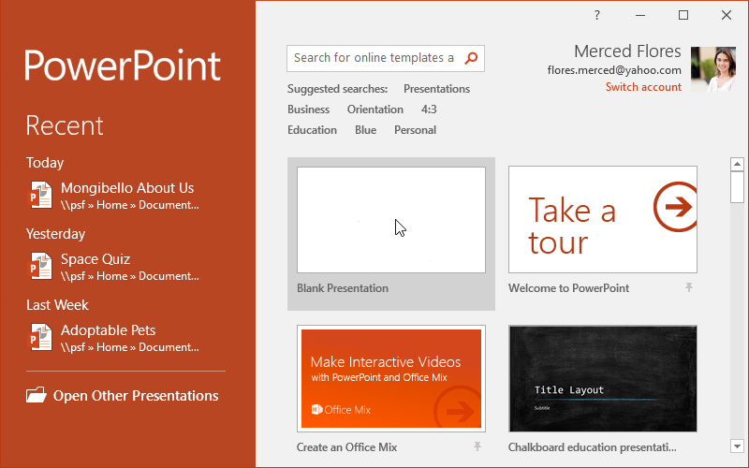
Powerpoint Interface
When you open PowerPoint for the first time, the Start Screen will appear. From here, you'll be able to create a new presentation, choose a template, and access your recently edited presentations. From the Start Screen, locate and select Blank Presentation to access the PowerPoint interface.

Slide 5
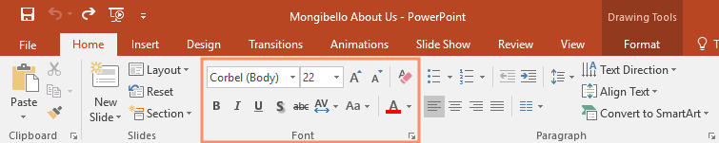
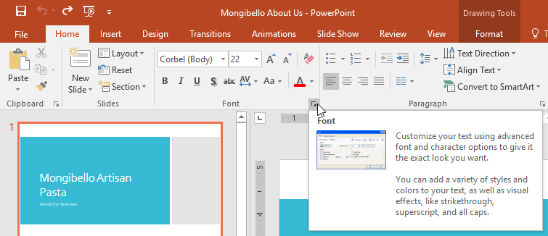
The Ribbon
PowerPoint uses a tabbed Ribbon system instead of traditional menus. The Ribbon contains multiple tabs, each with several groups of commands. For example, the Font group on the Home tab contains commands for formatting text in your document.
Some groups also have a small arrow in the bottom-right corner that you can click for even more options.

Slide 6
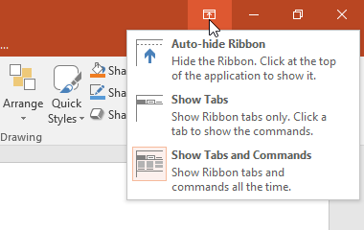

Showing and hiding the Ribbon
The Ribbon is designed to respond to your current task, but you can choose to minimize it if you find that it takes up too much screen space. Click the Ribbon Display Options arrow in the upper-right corner of the Ribbon to display the drop-down menu.
Auto-hide Ribbon: Auto-hide displays your workbook in full-screen mode and completely hides the Ribbon. To show the Ribbon, click the Expand Ribbon command at the top of screen.
Show Tabs: This option hides all command groups when they're not in use, but tabs will remain visible. To show the Ribbon, simply click a tab.
Show Tabs and Commands: This option maximizes the Ribbon. All of the tabs and commands will be visible. This option is selected by default when you open PowerPoint for the first time.

Slide 7
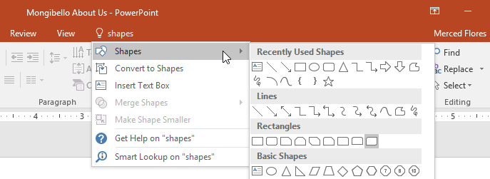
Using the Tell me feature
If you're having trouble finding command you want, the Tell Me feature can help. It works just like a regular search bar: Type what you're looking for, and a list of options will appear. You can then use the command directly from the menu without having to find it on the Ribbon.

Slide 8
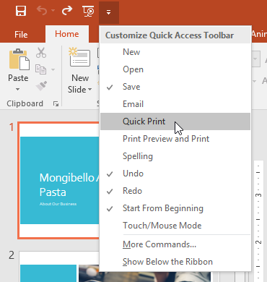
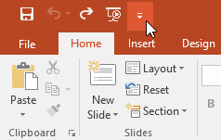
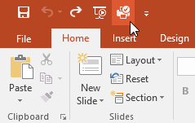
The Quick Access Toolbar
Located just above the Ribbon, the Quick Access Toolbar lets you access common commands no matter which tab is selected. By default, it includes the Save, Undo, Redo, and Start From Beginning commands. You can add other commands depending on your preference.
To add Commands to the Quick Access Toolbar:
Click the drop-down arrow to the right of the Quick Access Toolbar.
Select the command you want to add from the drop-down menu. To choose from more commands, select More Commands.
The command will be added to the Quick Access Toolbar.

Slide 9
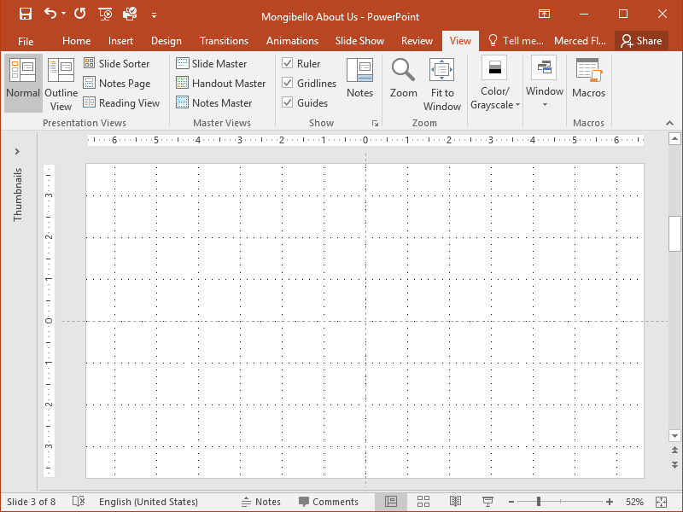
The Ruler, guides, and gridlines
PowerPoint includes several tools to help organize and arrange content on your slides, including the Ruler, guides, and gridlines. These tools make it easier to align objects on your slides. Simply click the check boxes in the Show group on the View tab to show and hide these tools.

Slide 10
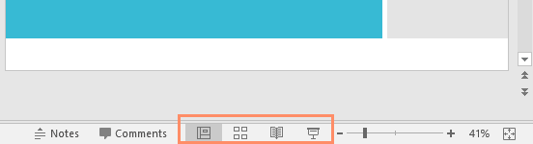
Zoom and other view options
PowerPoint has a variety of viewing options that change how your presentation is displayed. You can choose to view your presentation in Normal view, Slide Sorter view, Reading view, or Slide Show view. You can also zoom in and out to make your presentation easier to read.
Switching slide views
    Switching between different slide views is easy. Just locate and select the desired slide view command in the bottom-right corner of the PowerPoint window.

Slide 11
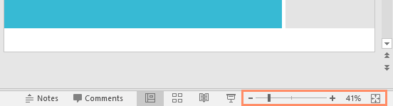
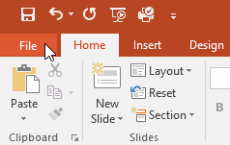
Zooming in and out
To zoom in or out, click and drag the zoom control slider in the bottom-right corner of the PowerPoint window. You can also select the + or - commands to zoom in or out by smaller increments. The number next to the slider displays the current zoom percentage, also called the zoom level.
Backstage view
Backstage view gives you various options for saving, opening, printing, and sharing your presentations. To access Backstage view, click the File tab on the Ribbon.

Slide 12
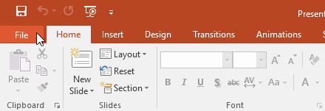
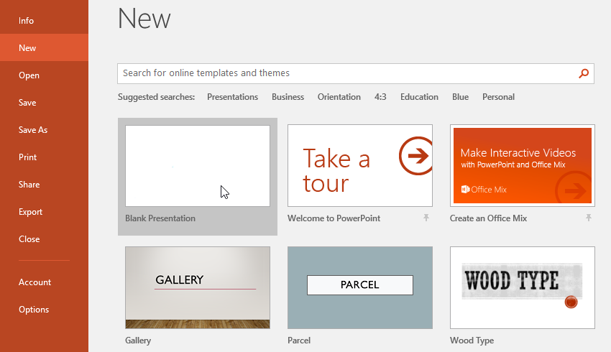
To create a new presentation:
When beginning a new project in PowerPoint, you'll often want to start with a new blank presentation.
Select the File tab to go to Backstage view
Select New on the left side of the window, then click Blank Presentation.
A new presentation will appear.

Slide 13
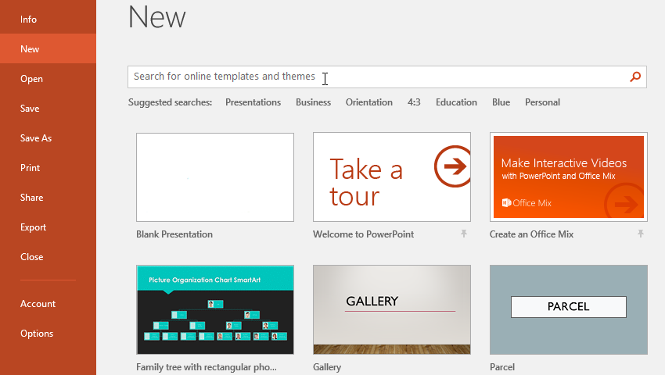
To create a new presentation from a template:
A template is a predesigned presentation you can use to create a new slide show quickly. Templates often include custom formatting and designs, so they can save you a lot of time and effort when starting a new project.
Click the File tab to access Backstage view, then select New.
You can click a suggested search to find templates or use the search bar to find something more specific.
Select the template to review it.
A preview of the template will appear, along with additional information on how the template can be used.
Click Create to use the selected template.
Creating a new presentation with a template
A new presentation will appear with the selected template.

Slide 14
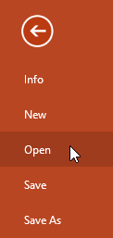
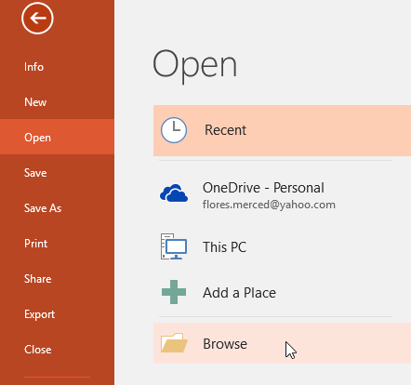
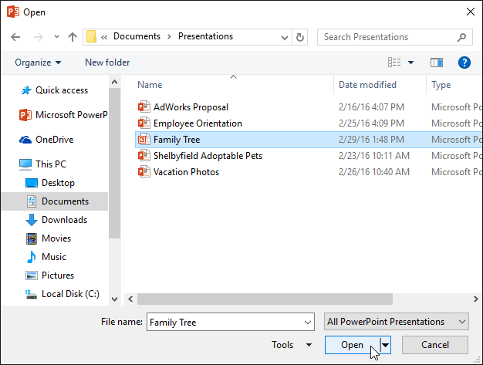
To open an existing presentation:
Select the File tab to go to Backstage view, then click Open.
Click Browse. Alternatively, you can choose OneDrive to open files stored on your OneDrive.
The Open dialog box will appear. Locate and select your presentation, then click Open.

Slide 15
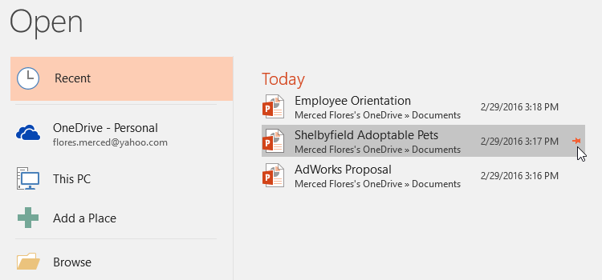
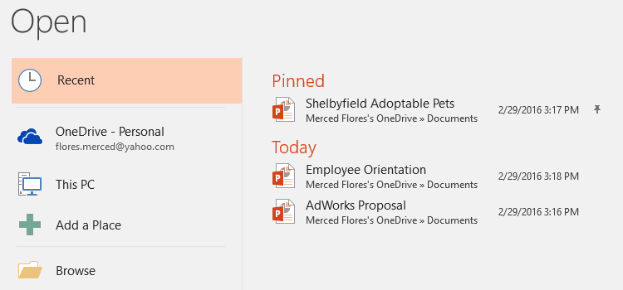
To pin a presentation:
Select the File tab to go to Backstage view, then click Open. Your Recent Presentations will appear.
Hover the mouse over the presentation you want to pin, then click the pushpin icon.
The presentation will stay in the Recent presentations list until it is unpinned. To unpin a presentation, click the pushpin icon again.

Slide 16
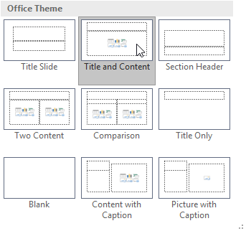
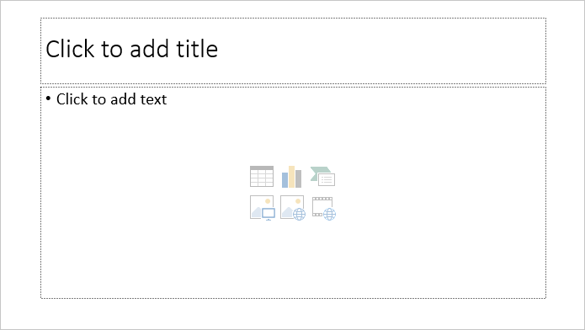
Understanding slides and slide layouts
When you insert a new slide, it will usually have placeholders to show you where content will be placed. Slides have different layouts for placeholders, depending on the type of information you want to include. Whenever you create a new slide, you'll need to choose a slide layout that fits your content.
Placeholders can contain different types of content, including text, images, and videos. Many placeholders have thumbnail icons you can click to add specific types of content. In the example below, the slide has placeholders for the title and content.

Slide 17
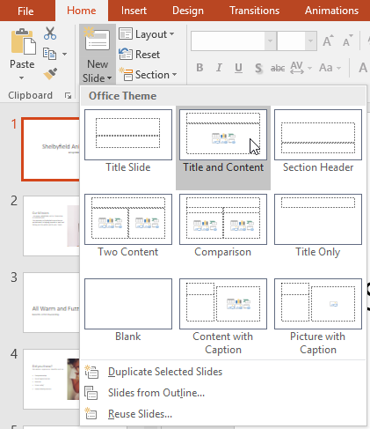
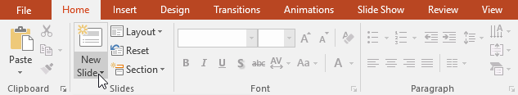
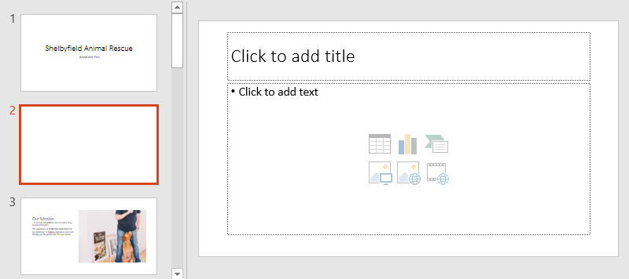
To insert a new slide
Whenever you start a new presentation, it will contain one slide with the Title Slide layout. You can insert as many slides as you need from a variety of layouts.
From the Home tab, click the bottom half of the New Slide command.
Choose the desired slide layout from the menu that appears.
The new slide will appear. Click any placeholder and begin typing to add text. You can also click an icon to add other types of content, such as a picture or a chart.

Slide 18
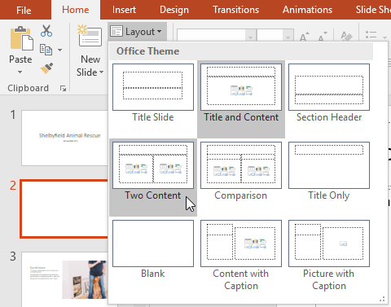
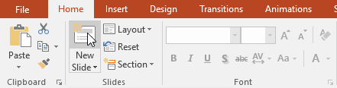
To insert a new slide(Cont.)
To change the layout of an existing slide, click the Layout command, then choose the desired layout.
To quickly add a slide that uses the same layout as the selected slide, click the top half of the New Slide command.

Slide 19
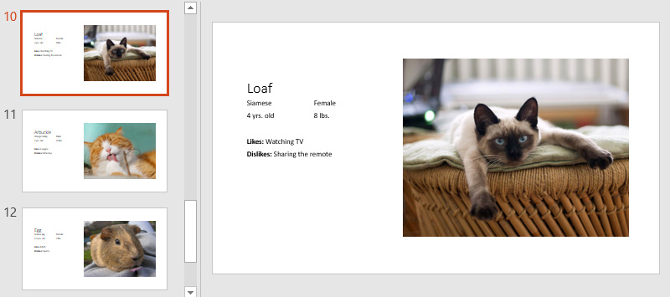
Organizing slides
PowerPoint presentations can contain as many slides as you need. The Slide Navigation pane on the left side of the screen makes it easy to organize your slides. From there, you can duplicate, rearrange, and delete slides in your presentation.

Slide 20
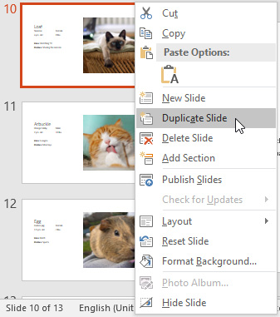
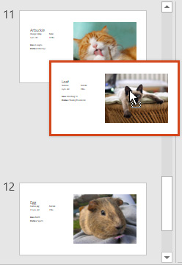
Working with slides
Duplicate slides: If you want to copy and paste a slide quickly, you can duplicate it. To duplicate slides, select the slide you want to duplicate, right-click the mouse, and choose Duplicate Slide from the menu that appears. You can also duplicate multiple slides at once by selecting them first.
Move slides: It's easy to change the order of your slides. Just click and drag the desired slide in the Slide Navigation pane to the desired position.
Delete slides: If you want to remove a slide from your presentation, you can delete it. Simply select the slide you want to delete, then press the Delete or Backspace key on your keyboard.

Slide 21
To copy and paste slides
If you want to create several slides with the same layout, you may find it easier to copy and paste a slide you've already created instead of starting with an empty slide.
Select the slide you want to copy in the Slide Navigation pane, then click the Copy command on the Home tab. Alternatively, you can press Ctrl+C on your keyboard.
In the Slide Navigation pane, click just below a slide (or between two slides) to choose a paste location. A horizontal insertion point will appear.
Click the Paste command on the Home tab. Alternatively, you can press Ctrl+V on your keyboard.
The slide will appear in the selected location.

Slide 22
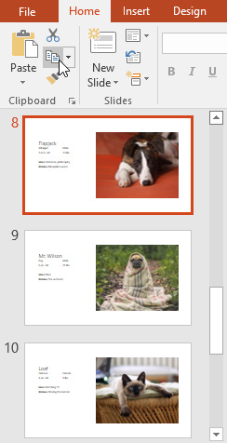
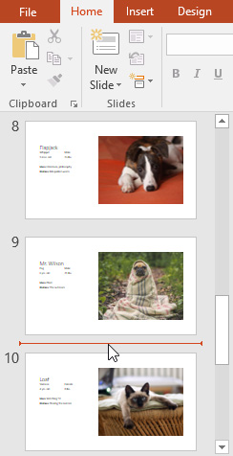

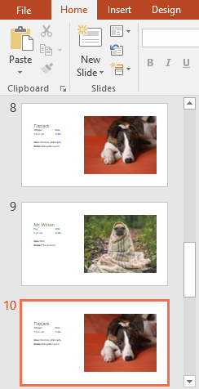
To copy and paste slides (Cont.)

Slide 23

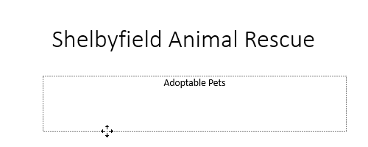
Customizing slide layouts
Sometimes you may find that a slide layout doesn't exactly fit your needs. For example, a layout might have too many—or too few—placeholders. You might also want to change how the placeholders are arranged on the slide. Fortunately, PowerPoint makes it easy to adjust slide layouts as needed.
Adjusting placeholders
To select a placeholder: Hover the mouse over the edge of the placeholder and click (you may need to click the text in the placeholder first to see the border). A selected placeholder will have a solid line instead of a dotted line.
To move a placeholder: Select the placeholder, then click and drag it to the desired location.

Slide 24

Customizing slide layouts(Cont.)
To resize a placeholder: Select the placeholder you want to resize. Sizing handles will appear. Click and drag the sizing handles until the placeholder is the desired size. You can use the corner sizing handles to change the placeholder's height and width at the same time.
To delete a placeholder: Select the placeholder you want to delete, then press the Delete or Backspace key on your keyboard.

Slide 25
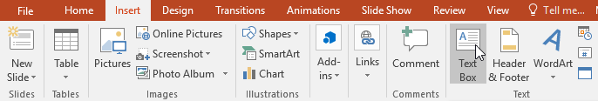

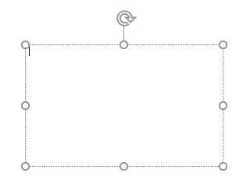
To add a text box
Text can be inserted into both placeholders and text boxes. Inserting text boxes allows you to add to the slide layout. Unlike placeholders, text boxes always stay in the same place, even if you change the theme.
From the Insert tab, select the Text Box command.
Click and drag to draw the text box on the slide.
The text box will appear. To add text, simply click the text box and begin typing.

Slide 26
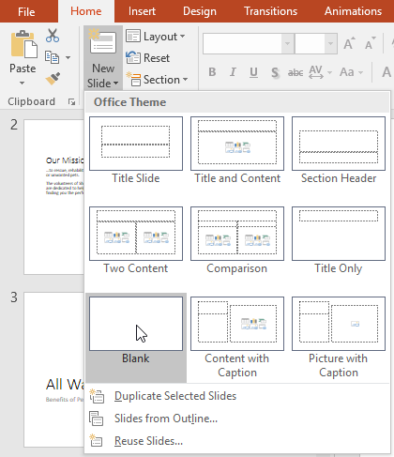
Using blank slides
If you want even more control over your content, you may prefer to use a blank slide, which contains no placeholders. Blank slides can be customized by adding your own text boxes, pictures, charts, and more.
To insert a blank slide, click the bottom half of the New Slide command, then choose Blank from the menu that appears.
While blank slides offer more flexibility, keep in mind that you won't be able to take advantage of the predesigned layouts included in each theme.

Slide 27
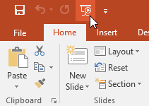
To play the presentation
Once you've arranged your slides, you may want to play your presentation. This is how you will present your slide show to an audience.
Click the Start From Beginning command on the Quick Access Toolbar to see your presentation.
The presentation will appear in full-screen mode.
You can advance to the next slide by clicking your mouse or pressing the spacebar on your keyboard. Alternatively, you can use the arrow keys on your keyboard to move forward or backward through the presentation.
Press the Esc key to exit presentation mode.
You can also press the F5 key at the top of your keyboard to start a presentation.

Slide 28
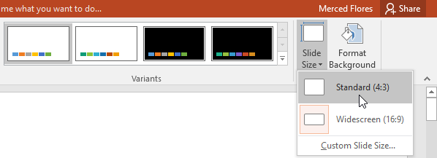
Customizing slides
To change the slide size:
  By default, all slides in PowerPoint 2013 use a 16-by-9—or widescreen—aspect ratio. You might know that widescreen TVs also use the 16-by-9 aspect ratio. Widescreen slides will work best with widescreen monitors and projectors. However, if you need your presentation to fit a 4-by-3 screen, it's easy to change the slide size to fit.
  To change the slide size, select the Design tab, then click the Slide Size command. Choose the desired slide size from the menu that appears, or click Custom Slide Size for more options.

Slide 29
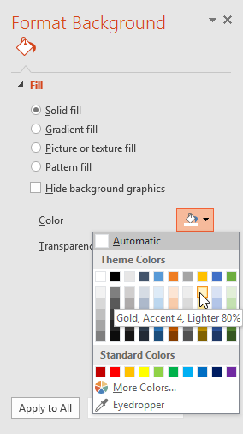
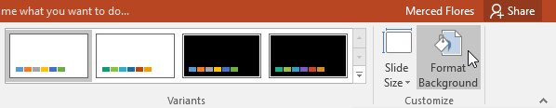
Customizing slides (Cont.)
To format the slide background
By default, all slides in your presentation use a white background. It's easy to change the background style for some or all of your slides. Backgrounds can have a solid, gradient, pattern, or picture fill.
Select the Design tab, then click the Format Background command.
The Format Background pane will appear on the right. Select the desired fill options. In our example, we'll use a Solid fill with a light gold color.

Slide 30
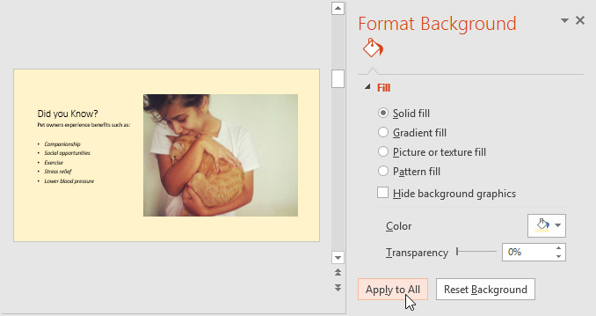
Customizing slides (Cont.)
To format the slide background
The background style of the selected slide will update.
If you want, you can click Apply to All to apply the same background style to all slides in your presentation.

Slide 31
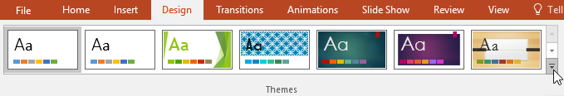
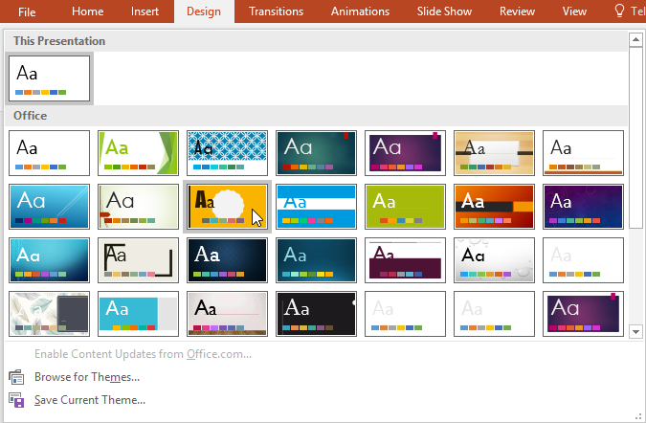
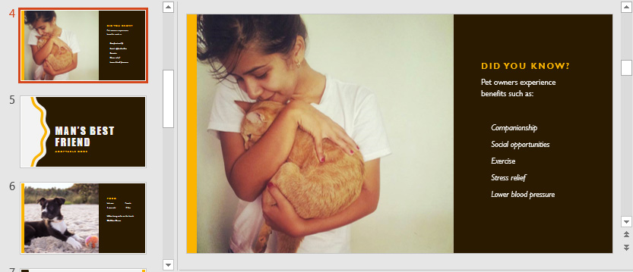
To apply a theme
A theme is a predefined combination of colors, fonts, and effects that can quickly change the look and feel of your entire slide show. Different themes also use different slide layouts, which can change the arrangement of your existing placeholders. We'll talk more about themes later in our Applying Themes lesson.
Select the Design tab on the Ribbon, then click the More drop-down arrow to see all of the available themes.
Select the desired theme.
The theme will be applied to your entire presentation.

Slide 32
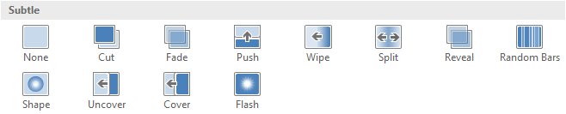
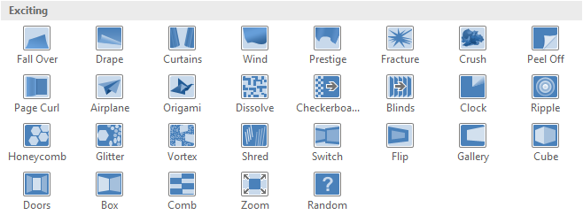

About transitions
There are three categories of unique transitions to choose from, all of which can be found on the Transitions tab.
Subtle: These are the most basic types of transitions. They use simple animations to move between slides.
Exciting: These use more complex animations to transition between slides. While they're more visually interesting than Subtle transitions, adding too many can make your presentation look less professional. However, when used in moderation they can add a nice touch between important slides.
Dynamic Content: If you're transitioning between two slides that use similar slide layouts, dynamic transitions will move only the placeholders, not the slides themselves. When used correctly, dynamic transitions can help unify your slides and add a further level of polish to your presentation.

Slide 33
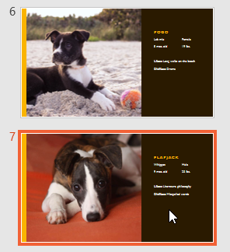
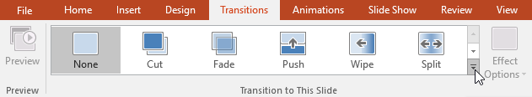
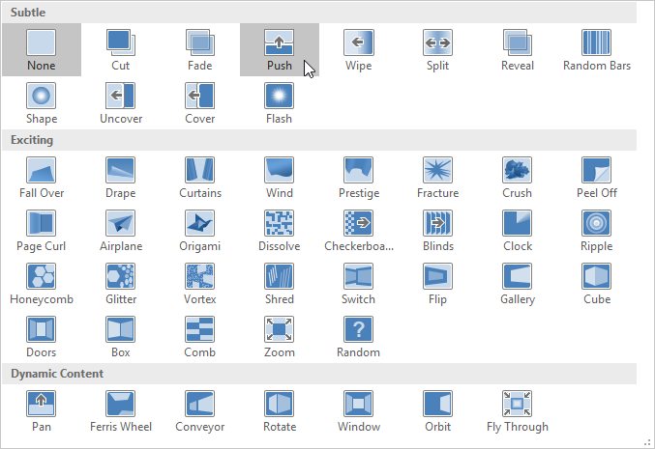
About transitions (Cont.)
To apply a transition
Select the desired slide from the Slide Navigation pane. This is the slide that will appear after the transition.
Click the Transitions tab, then locate the Transition to This Slide group. By default, None is applied to each slide.
Click the More drop-down arrow to display all transitions.
Click a transition to apply it to the selected slide. This will automatically preview the transition.

Slide 34



About transitions (Cont.)
To apply a transition
You can use the Apply To All command in the Timing group to apply the same transition to all slides in your presentation. Keep in mind that this will modify any other transitions you've applied.
To preview a transition
Click the Preview command on the Transitions tab.
Click the Play Animations command in the Slide Navigation pane.

Slide 35


About transitions (Cont.)
Modifying transitions
Some transitions do not allow you to modify the direction.
To modify the transition effect:
You can quickly customize the look of a transition by changing its direction.
Select the slide with the transition you want to modify.
Click the Effect Options command and choose the desired option. These options will vary depending on the selected transition.
The transition will be modified, and a preview of the transition will appear.
To modify the transition duration:
Select the slide with the transition you want to modify.
In the Duration field in the Timing group, enter the desired time for the transition. In this example, we'll decrease the time to half a second—or 00.50—to make the transition faster.

Slide 36

About transitions (Cont.)
To add sound
Select the slide with the transition you want to modify.
Click the Sound drop-down menu in the Timing group.
Click a sound to apply it to the selected slide, then preview the transition to hear the sound.
Sounds are best used in moderation. Applying a sound between every slide could become overwhelming or even annoying to an audience when presenting your slide show.

Slide 37

About transitions (Cont.)
To remove a transition
Select the slide with the transition you want to remove.
Choose None from the Transition to This Slide group. The transition will be removed.
To remove transitions from all slides, apply the None transition to a slide, then click the Apply to All command.

Slide 38

Advancing slides
Normally, in Slide Show view you would advance to the next slide by clicking your mouse or by pressing the spacebar or arrow keys on your keyboard. The Advance Slides setting in the Timing group allows the presentation to advance on its own and display each slide for a specific amount of time. This feature is especially useful for unattended presentations, such as those at a trade show booth.
To advance slides automatically:
Select the slide you want to modify.
Locate the Timing group on the Transitions tab. Under Advance Slide, uncheck the box next to On Mouse Click.
In the After field, enter the amount of time you want to display the slide. In this example, we will advance the slide automatically after 1 minute and 15 seconds, or 01:15:00.
Select another slide and repeat the process until all slides have the desired timing. You can also click the Apply to All command to apply the same timing to all slides.

Slide 39



Slide Views
PowerPoint includes several different slide views, which are all useful for various tasks. The slide view commands are located in the bottom-right of the PowerPoint window. There are four main slide views.
Normal view: This is the default view, where you create and edit slides. You can also move slides in the Slide Navigation pane on the left.
Slide sorter view: In this view, you'll see a thumbnail version of each slide. You can drag and drop slides to reorder them quickly.

Slide 40


Slide Views (Cont.)
Reading view: This view fills the PowerPoint window with a preview of your presentation. It includes easily accessible navigation buttons at the bottom-right.
Slide show view: This is the view you'll use to present to an audience. This command will begin the presentation from the current slide. You can also press F5 on your keyboard to start from the beginning. A menu will appear in the bottom-left corner when you move the mouse. These commands allow you to navigate through the slides and access other features, such as the pen and highlighter.

Slide 41
Save and Save As
PowerPoint offers two ways to save a file: Save and Save As. These options work in similar ways, with a few important differences.
Save: When you create or edit a presentation, you'll use the Save command to save your changes. You'll use this command most of the time. When you save a file, you'll only need to choose a file name and location the first time. After that, you can just click the Save command to save it with the same name and location.
Save As: You'll use this command to create a copy of a presentation while keeping the original. When you use Save As, you'll need to choose a different name and/or location for the copied version.
It's important to save your presentation whenever you start a new project or make changes to an existing one. Saving early and often can prevent your work from being lost. You'll also need to pay close attention to where you save the presentation so it will be easy to find later.

Slide 42


To save a presentation:
Locate and select the Save command on the Quick Access Toolbar.
If you're saving the file for the first time, the Save As pane will appear in Backstage view.
You'll then need to choose where to save the file and give it a file name. Click Browse to select a location on your computer. Alternatively, you can click OneDrive to save the file to your OneDrive.

Slide 43

To Save a Presentation (Cont.)
The Save As dialog box will appear. Select the location where you want to save the presentation.
Enter a file name for the presentation, then click Save.
The presentation will be saved. You can click the Save command again to save your changes as you modify the presentation.
You can also access the Save command by pressing Ctrl+S on your keyboard.

Slide 44

Using Save As to make a copy
If you want to save a different version of a presentation while keeping the original, you can create a copy. For example, if you have a file named Client Presentation you could save it as Client Presentation 2 so you'll be able to edit the new file and still refer back to the original version.
To do this, you'll click the Save As command in Backstage view. Just like when saving a file for the first time, you'll need to choose where to save the file and give it a new file name.

Slide 45






To change the default save location
If you don't want to use OneDrive, you may be frustrated that OneDrive is selected as the default location when saving. If you find this inconvenient, you can change the default save location so This PC is selected by default.
Click the File tab to access Backstage view.
Click Options.
The PowerPoint Options dialog box will appear. Select Save, check the box next to Save to Computer by default, then click OK. The default save location will be changed.

Slide 46


To use AutoRecover
Open PowerPoint. If autosaved versions of a file are found, the Document Recovery pane will appear.
Click to open an available file. The presentation will be recovered.
By default, PowerPoint autosaves every 10 minutes. If you are editing a presentation for less than 10 minutes, PowerPoint may not create an autosaved version.
If you don't see the file you need, you can browse all autosaved files from Backstage view. Just select the File tab, click Manage Presentation, then choose Recover Unsaved Presentations.

Slide 47
Exporting presentations
By default, PowerPoint presentations are saved in the .pptx file type. However, there may be times when you need to use another file type, such as a PDF or PowerPoint 97-2003 presentation. It's easy to export your presentation from PowerPoint in a variety of file types.
PDF: Saves the presentation as a PDF document instead of a PowerPoint file
Video: Saves the presentation as a video
Package for CD: Saves the presentation in a folder along with the Microsoft PowerPoint Viewer, a special slide show player anyone can download
Handouts: Prints a handout version of your slides
Other file type: Saves in other file types, including PNG and PowerPoint 97-2003

Slide 48

Exporting presentations (Cont.)
Click the File tab to access Backstage view.
Click Export, then choose the desired option. In our example, we'll select Change File Type.

Slide 49

Exporting presentations (Cont.)
Select a file type, then click Save As.

Slide 50

Exporting presentations (Cont.)
The Save As dialog box will appear. Select the location where you want to export the presentation, type a file name, then click Save.

Slide 51

Exporting presentations (Cont.)
You can also use the Save as type drop-down menu in the Save As dialog box to save presentations in a variety of file types. Be careful to choose a file type others will be able to open.

Slide 52


